Slide 1
Stacey Norris, LCSW
VISN 9 Lead Women Veterans Program Manager
U.S. Department of Veterans Affairs

Slide 3
VISN 9- Midsouth Healthcare Network
VISN 9 is an integrated healthcare delivery system comprised of three VA Medical Centers (VAMCs), located in Memphis, TN, Louisville, KY, and Mountain Home, TN, and two Health Care Systems located in Lexington, KY, and Nashville and Murfreesboro, TN.
Midsouth Healthcare Network has 57 outpatient clinics, covers almost 100,000 square miles, 22 congressional districts, 272 counties in KY, TN, and portions of GA, IN, VA, MS, and AR.
There are 383,800 Veteran enrollees in VISN 9's geographic area with approximately 274,200 users for VA healthcare.

Slide 4
Women Veteran Enrollees

Slide 5
Enrollees by Facility System (FY23-AUG)
Facility Location
Middle TN
Memphis, TN
Mt. Home, TN
Louisville, KY
Lexington, KY

Slide 6
Women Veteran Enrollees by Age

Slide 7
WOMEN VETERANS HEALTH CARE​ Did you know we offer…
Fertility Services
Mental Health
Military Sexual Trauma Services
Menopause Counseling & Hormone Therapy
Intimate Partner Violence Assistance
Lactation Rooms
Benefits & Eligibility Information
Women Only Groups
Birth Control & Plan B
Osteoporosis Counseling
Weight Loss/Nutrition/Fitness
Maternity Care Coordination
GYN Care
Mammography

Slide 8
Breast Cancer Awareness Month
One in eight women will be diagnosed with breast cancer in their lifetime.
The risk of breast cancer increases with age.
Breast cancer is the most common cancer and second most common cause of cancer deaths in American women.
Black women are more likely to die from breast cancer than other races/ethnicities.
VISN 9 has mammography available in Middle TN, and Louisville, KY. All other Women Veterans are coordinated within the community.

Slide 9
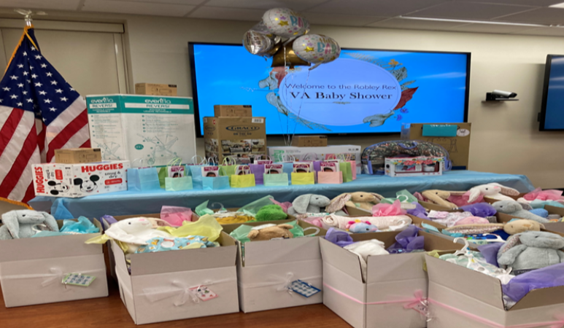
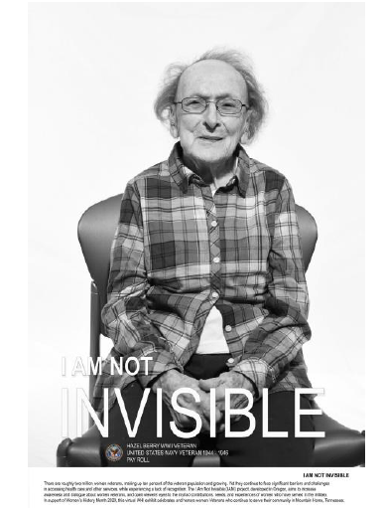
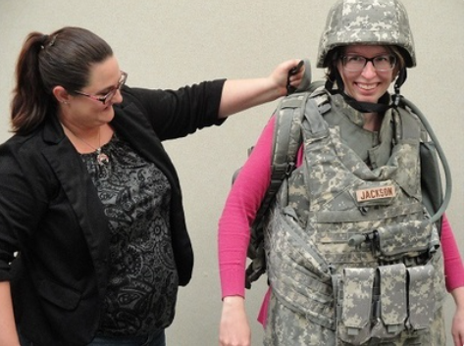
Culture Change
Renaming of Spaces
End Harassment
Education &Training
Focus Groups & Public Forums
Baby Showers
Open Houses
IANI Campaign and “I am a Veteran”.
Notes:
Mountain Home VA dedicated and named the CLC dining hall after Veteran Hazel Berry. Veteran Berry was a World War II Navy Veteran. From 1966 to 2020, Veteran Berry volunteered over 12,446 hours at James H. Quillen Medical Center helping care for patients and visiting fellow veterans.

Slide 10
Women Veterans Program

Slide 11
Women Veterans Program Managers
WVPM | Location | Email
Stacey Norris, LCSW, VISN 9 Lead | Nashville, TN, VISN 9 Office | stacey.norris@va.gov
Lynn Daugherty, RN | Tennessee Valley Healthcare System | lynn.daugherty2@va.gov
Dr. Charmin Thomas, DNSc, APN-BC | Memphis, TN VAMC | charmin.thomas@va.gov
Nichole Chapin, LCSW | Mountain Home, TN VAMC | nichole.chapin@va.gov
Emily Watts, LCSW | Louisville, KY VAMC | emily.watts@va.gov
Jimalee Ross, LCSW | Lexington, KY Healthcare System | jimalee.ross@va.gov

Slide 12
Questions

