Slide 2
Department of Tennessee
Commander
Adjutant
Treasurer
Training

Slide 3
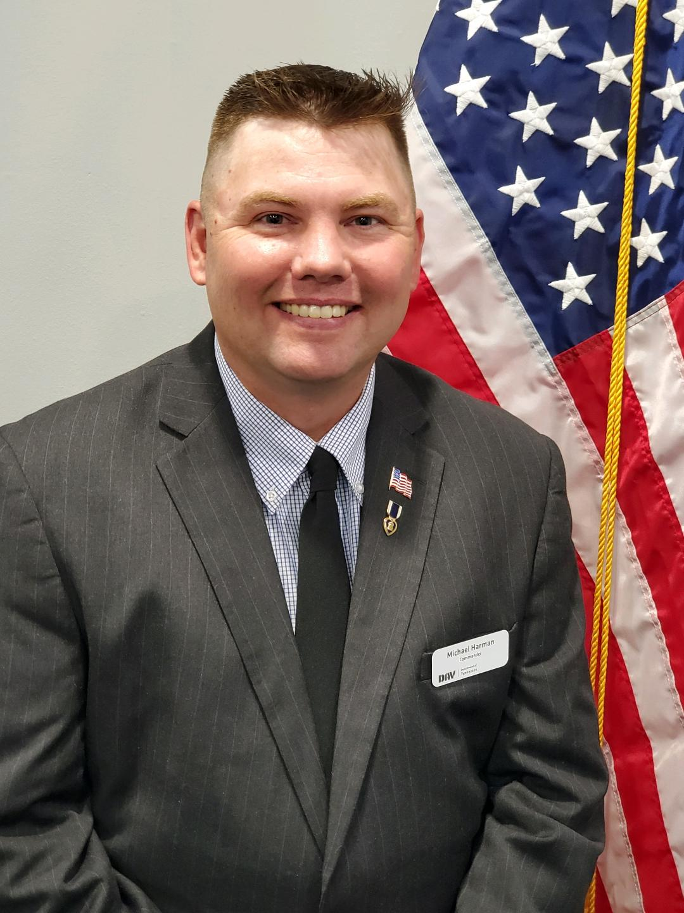
Michael L. Harman II
DAV member since August 2012
TN State Commander 2020 thru 2022
Prior National POW / MIA committee member
Department of TN LVAP coordinator
Commander of DAV Chapter 39 since 2014
Chapter 39 Service Officer
Multiple Chapter and Department offices held

Slide 4
MISSION STATEMENT
We are dedicated to one single purpose: empowering veterans to lead high-quality lives with respect and dignity. We accomplish this by ensuring that veterans and their families can access the full range of benefits available to them; fighting for the interests of America’s injured heroes on Capitol Hill; and educating the public about the great sacrifices and needs of veterans transitioning back to civilian life.
This mission is carried forward by:
• Providing free, professional assistance to veterans and their families in obtaining benefits and services earned through military service and provided by the Department of Veterans Affairs and other agencies of government.
• Providing outreach concerning its program services to the American people generally, and to disabled veterans and their families specifically.
• Representing the interests of disabled veterans, their families, their widowed spouses and their orphans before Congress, the White House and the judicial branch, as well as state and local government.
• Extending DAV’s mission of hope into the communities where these veterans and their families live through a network of state-level departments and local chapters.
• Providing a structure through which disabled veterans can express their compassion for their fellow veterans through a variety of volunteer programs.

Slide 5
How DAV Fulfills Its Mission

Slide 7
Annual Financial Report
AFR

Slide 8
Annual Financial Report
AFR
POP QUIZ!
When is the AFR Due?
By September 30
Any department or chapter that has not submitted an annual financial report
by September 30 will be considered in a delinquent status, which may
subject the department/chapter to suspension or revocation of its charter.

Slide 9
What does the AFR show?
We had money left over from last year
We received money this year
We spent money
We now have money left over
Begin with the previous year’s AFR Ending Balance
as your Beginning Balance for the current year
REMINDER: DAVs Fiscal Year (FY) is 01 July through 30 June

Slide 10
Annual Financial Report
AFR

Slide 11
Annual Financial Report
AFR
Let's talk about
INCOME
Lines 1 through 10

Slide 12
Annual Financial Report
AFR
Line 1
All Funding from National Headquarters
Membership per capita dues
Columbia Trust Grants
Department Fundraising or Revenue Sharing Program distributions

Slide 13
Annual Financial Report
AFR
Line 2
Forget-Me-Not Drive Receipts
Report total gross receipts from Forget-Me-Not drive
during the accounting period.

Slide 14
Annual Financial Report
AFR
Line 3 : Bingo Gross Receipts
Line 4: Thrift Store Gross Receipts
Line 5: Bar/Lounge Gross Receipts

Slide 15
Annual Financial Report
AFR
Line 6
Interest and Dividend Income
Report interest and dividends received from checking accounts, savings accounts, and
certificates of deposit during the accounting period.
Interest and dividend income received from investments
listed on line 26 should be reported on
line 9 as investment income.

Slide 16
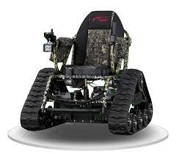
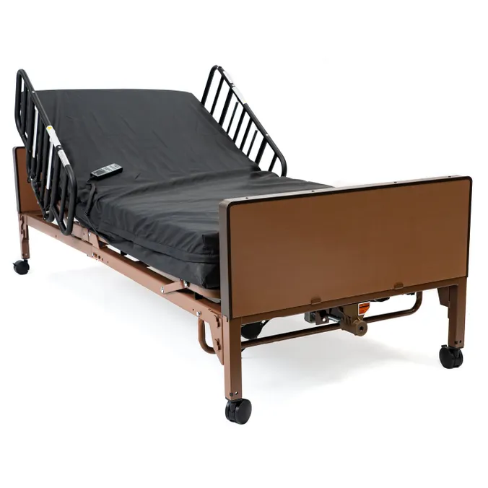
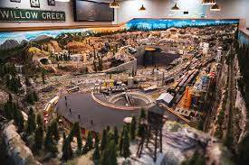
Annual Financial Report
AFR
Line 7
In-Kind Donations

Slide 17
Annual Financial Report
AFR
Line 7
In-Kind Donations
continued
Report the total value of in-kind donations
that were redistributed during the accounting period.
Attach required schedule listing the donor’s name and item donated.
Example:
Schedule for Line 7
Medical Store - Power Wheelchair $ 700.00
Jane Ross - Hospital Bed $ 900.00
$ 1,600.00

Slide 18
Annual Financial Report
AFR
Line 8
Increase in Market Value of Investments on Line 26
Report any increase in the market value of investments reported
on line 26 as of the end of the accounting period (June 30).
(i.e. stocks, bonds, mutual funds and any other securities)

Slide 19
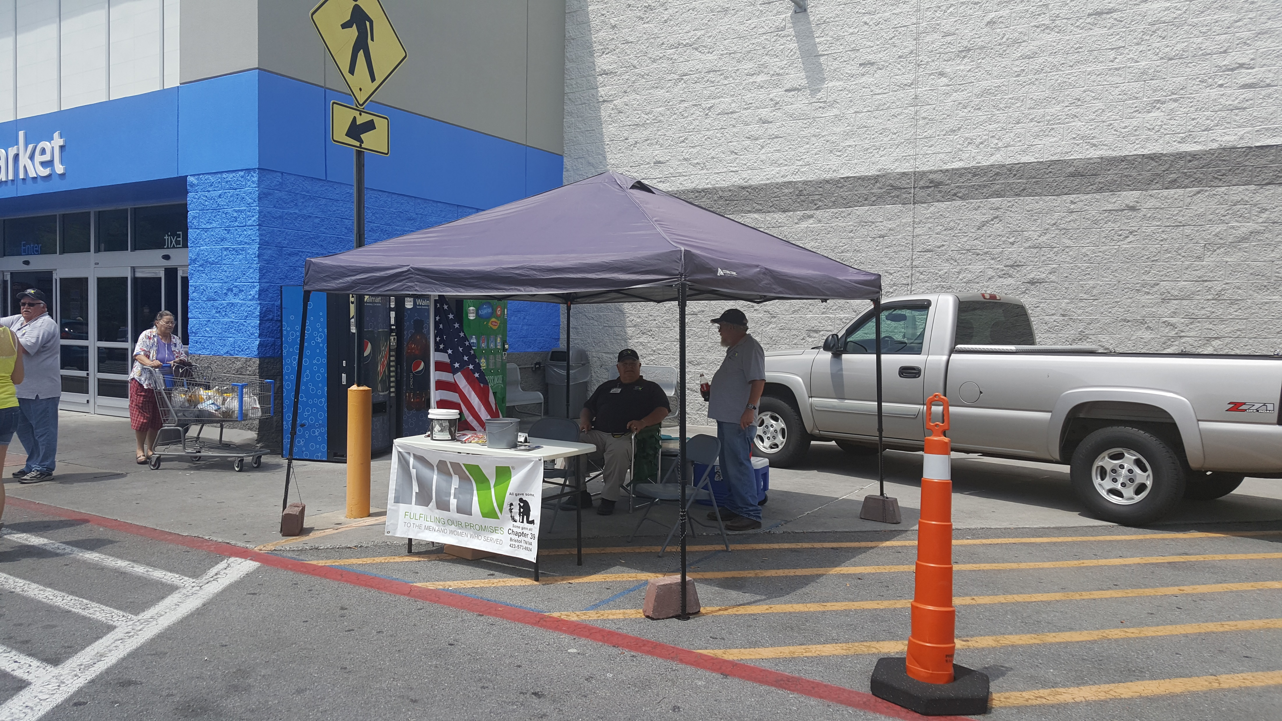
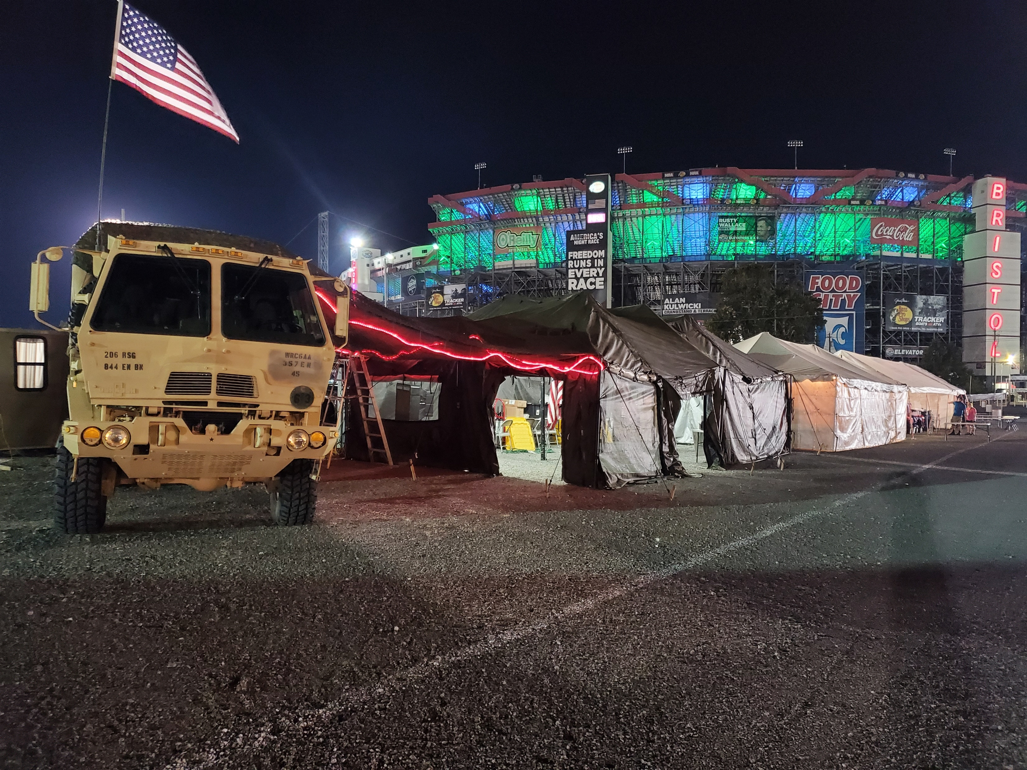
Annual Financial Report
AFR
Line 9
Other Income
Schedule for line 9
-Donations $ 10,310.00
Business Donations $ 5,000.00
Bequest $ 4,000.00
Jar Donations $ 1,000.00
Member Donations $ 310.00
-Fundraising $ 1,690.00
Quilt Raffle $ 1,000.00
Car Show $ 690.00
-DAV Membership Dues $ 400.00
-Refunds $ 525.00
-Resale Items Proceeds $ 100.00
TOTAL $ 13,025.00

Slide 20
Annual Financial Report
AFR
Line 10
Total Income
The sum of lines 1 thru 9.
Do NOT include the Beginning
Balance amount.

Slide 21
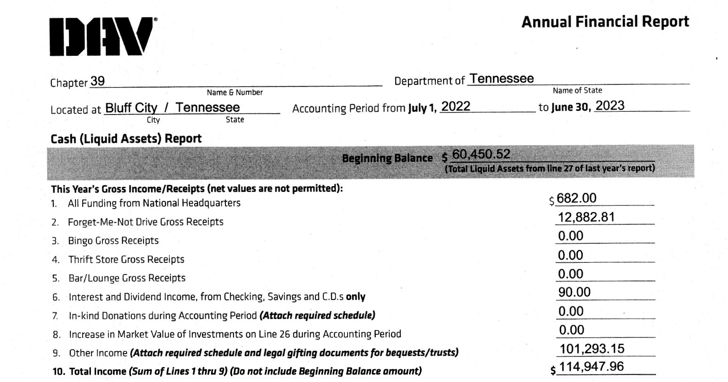
Annual Financial Report
AFR

Slide 22
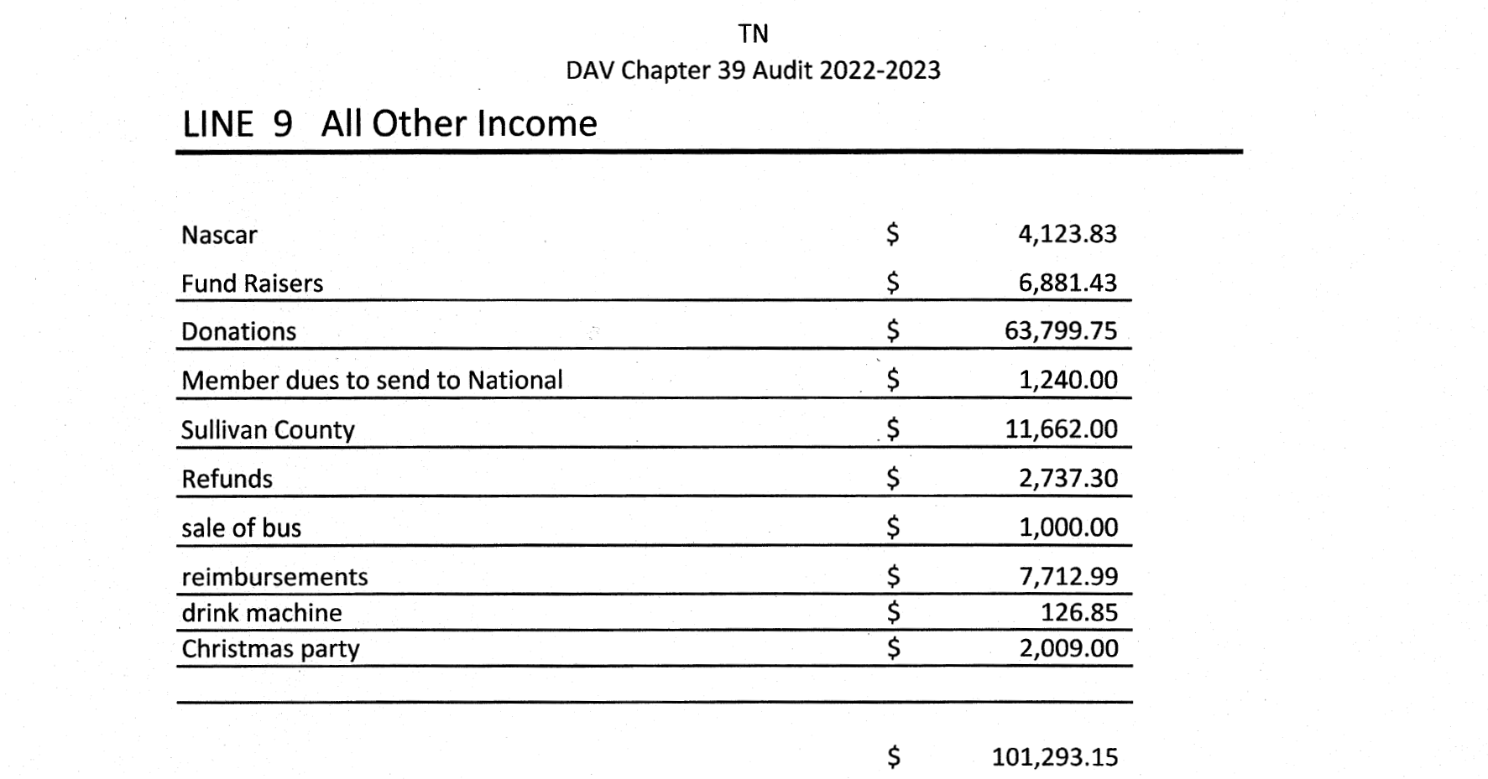
Annual Financial Report
AFR

Slide 23
Annual Financial Report
AFR
Expenses

Slide 24
Annual Financial Report
AFR
Line 11
Administrative Personnel Salaries, Benefits,
Payroll Taxes & Payroll Processing Fees

Slide 25
Annual Financial Report
AFR
Line 11
Administrative Personnel Salaries, Benefits,
Payroll Taxes & Payroll Processing Fees
Line 11: Salaries of paid employees (except those listed below)
CSO/DSO and HSC’s - line 14
Bingo employees belong- line 16
Bar/Lounge employees - line 18

Slide 26
Annual Financial Report
AFR
Line 11 Continued
Report total amount of all salaries, employee benefits and payroll taxes
for administrative personnel only and any related payroll processing fees.
Attach required schedule providing the full names of all administrative personnel,
their job title and the amount of each individual’s compensation, as well as
expenses related to payroll processing.
Do not include any salaries, employee benefits, payroll taxes or related payroll processing fees
for service personnel (i.e. department/chapter service officers, hospital service coordinators),
bingo employees, or bar/lounge employees as these should be listed on
separate schedules for lines 14, 16, and 18 respectively.

Slide 27
Annual Financial Report
AFR
Line 12
Conventions/Conferences/Seminars/Meetings
Report total amount of expenses for conventions, conferences, schools of instruction,
seminars and meetings, including monthly membership meetings.
Attach required schedule listing the specific event and the total amount
expended/disbursed for each event.
All travel and lodging expenses, advertisements, hospitality rooms and all other expenses
directly related to the event should be included in the total amount reported for each event.

Slide 28
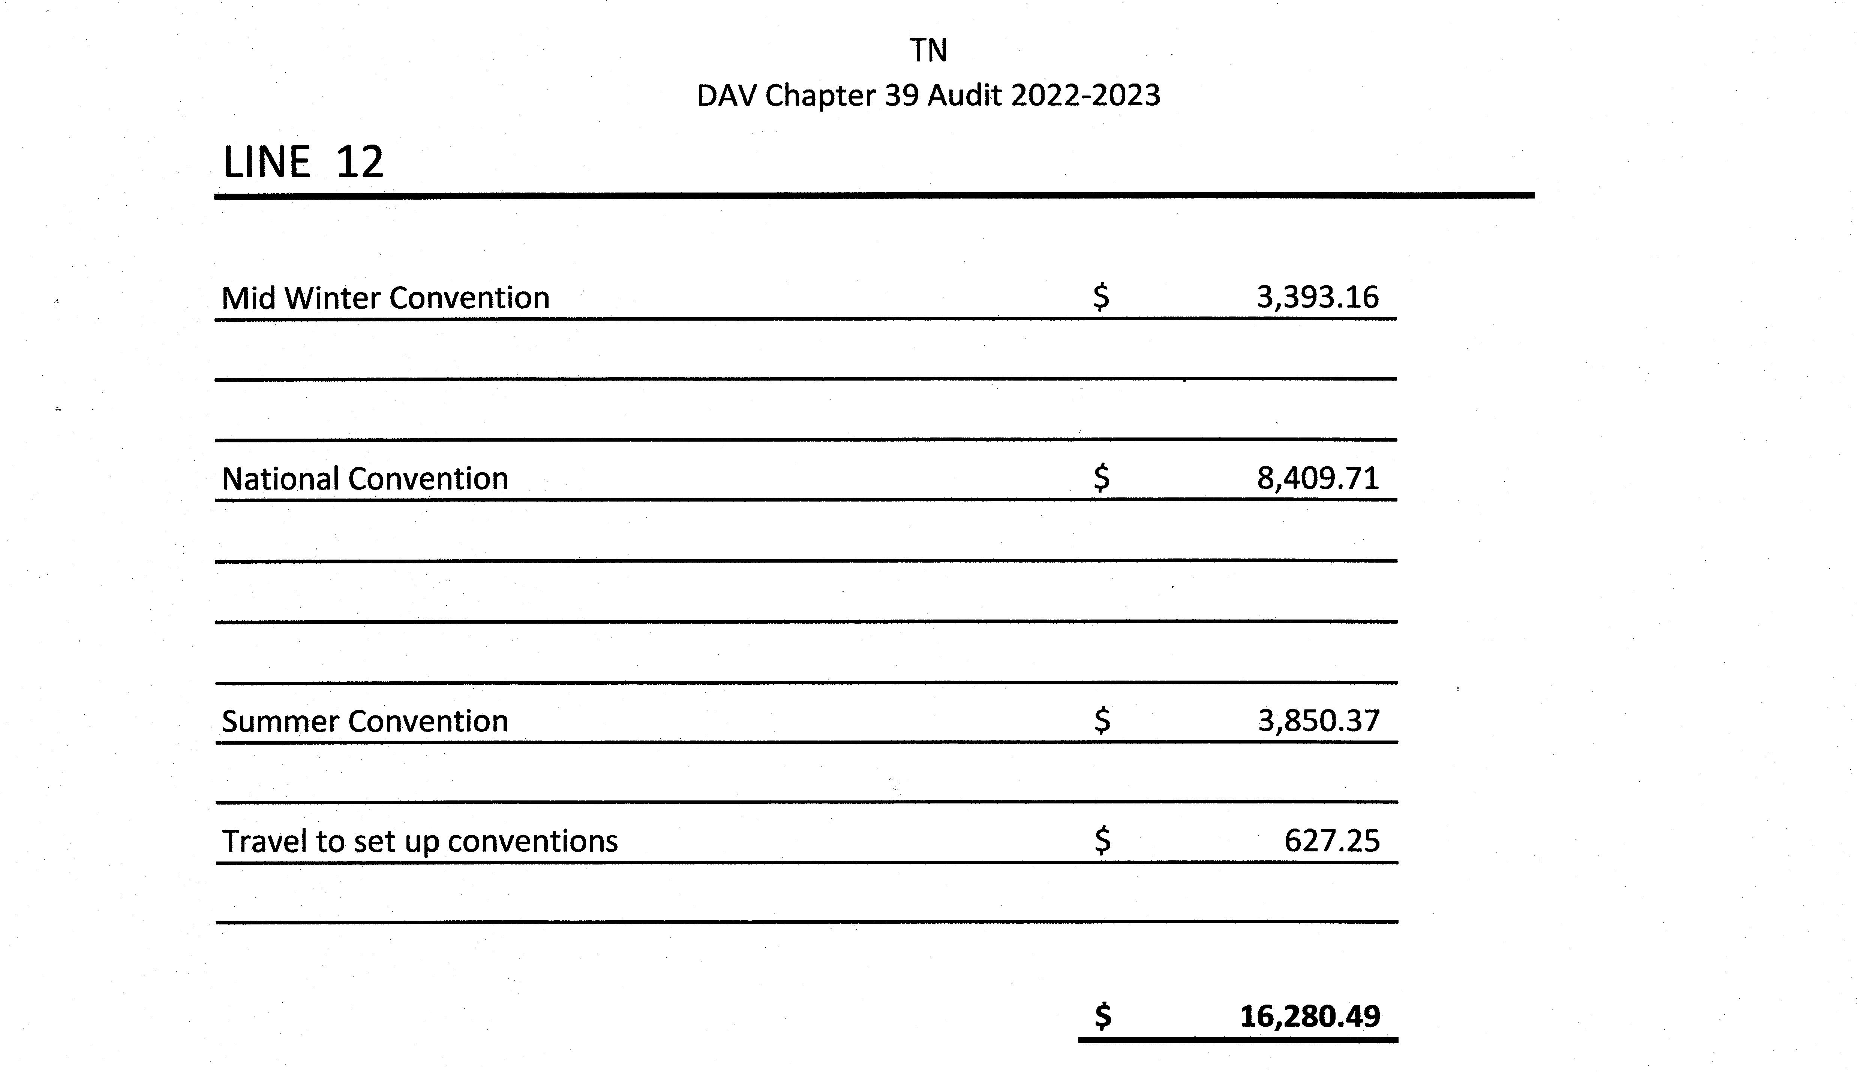
Annual Financial Report
AFR
Line 12 Schedule Example

Slide 29
Annual Financial Report
AFR
Line 13
Postage and Office Supplies

Slide 30
Annual Financial Report
AFR
Line 13 continued
Report total amount of expenses for administrative and non-service related postage
and office supplies (pens, paper, ink cartridges).
The purchase of furniture or equipment (e.g. computers, printers, desks)
should not be listed on line 13, but should instead be listed on the lines for
which the items were purchased.
Service related postage should be reported on line 14.

Slide 31
Annual Financial Report
AFR
Line 14
Service Expenses

Slide 32
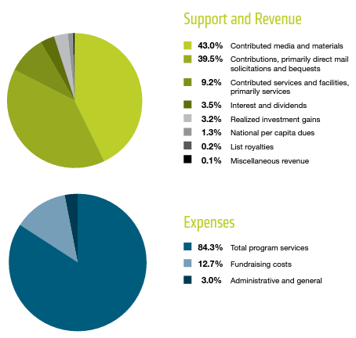
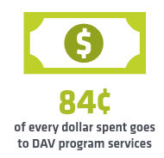
Annual Financial Report
AFR
Line 14 continued
Why should this line always be your biggest expense & Why is it important?
All the money raised through your fundraising goes toward DAV's services,
and every dollar donated will result in $179 in benefits for veterans.

Slide 33
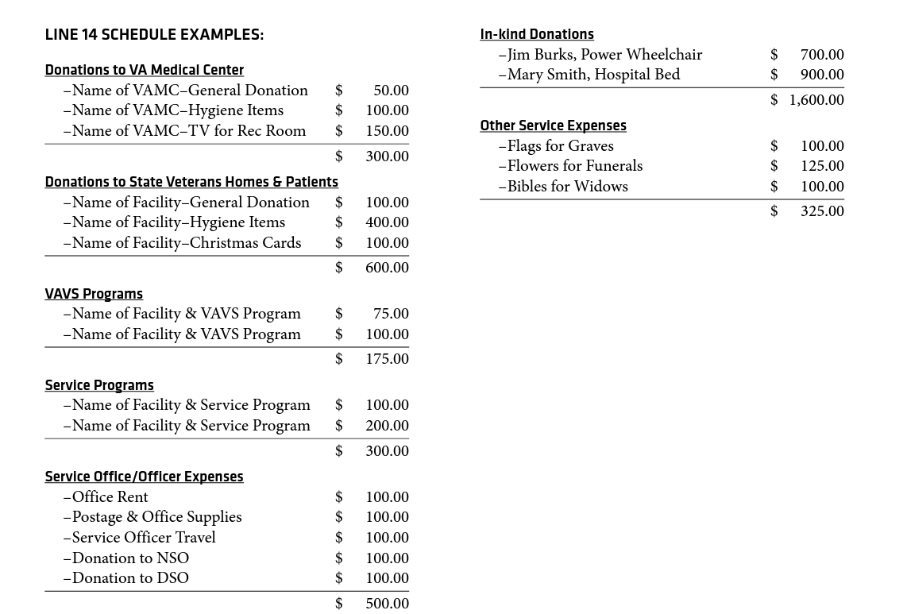
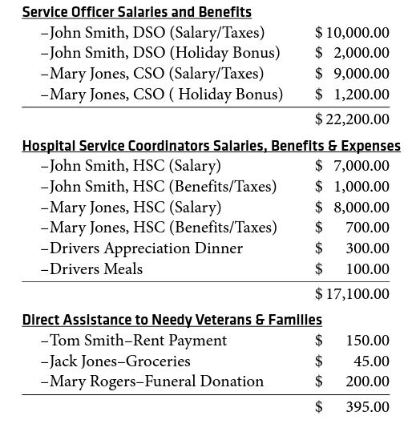
Annual Financial Report
AFR

Slide 34
Annual Financial Report
AFR
Line 15
Forget-Me-Not Expenses
$180.00
FMN Flowers
$75.00
(1,000 per box)
$12.15
Report total amount of Forget-Me-Not drive expenses, including flowers,
cans, posters, volunteer meals and all other expenses directly related to drive.
$9.75

Slide 35
Annual Financial Report
AFR
Line 16
Bingo Expenses
Report total amount of expenses for any non-service related bingo operation. Attach required schedule
to include the payout to players, all bingo salaries (list the full name, job title and amount of salary or
other compensation for each bingo employee), payroll taxes, related supplies and any other expenses that
are directly related to the operation of bingo. Please bear in mind there are some states which prohibit the
payment of any compensation to bingo workers by a charity/nonprofit.
NOTE: Expenses for voluntary bingo
sessions held for disabled veterans at any VAMC and/or nursing home for veterans should be reported on
line 14.
The Cost of Goods Sold should NOT be included on the financial report as it is the beginning inventory
plus purchases made minus the ending the inventory, which is not an actual cash disbursement. Only the
actual inventory purchases made during the accounting period should be reported.

Slide 36
Annual Financial Report
AFR
Line 17
Thrift Store Expenses
Report total amount of expenses for any thrift store operation. Attach required schedule to include
rent, utilities, all thrift store salaries (list the full name, job title and amount of salary or other
compensation for each thrift store employee, payroll taxes, management fees, and any other expenses
that are directly related to the operation of the thrift store.
NOTE: The Cost of Goods Sold should NOT
be included on the financial report as it is the beginning inventory plus purchases made minus the ending
the inventory, which is not an actual cash disbursement. Only the actual inventory purchases made during
the accounting period should be reported.

Slide 37
Annual Financial Report
AFR
Line 18
Bar/Lounge Expenses
Report total amount of expenses for any bar/lounge operation. Attach required schedule to include
all bar/lounge salaries (list the full name, job title and amount of salary or other compensation for
each bar/ lounge employee), payroll taxes, beverage purchases, food purchases, related supplies,
equipment and any other expenses that are directly related to the operation of the bar/lounge.
NOTE: The Cost of Goods Sold should NOT be included on the financial report as it is the beginning
inventory plus purchases made minus the ending the inventory, which is not an actual cash disbursement.
Only the actual inventory purchases made during the accounting period should be reported.

Slide 38
Annual Financial Report
AFR
Line 19
Chapter Home/Department HQ
Operational Expenses
Report total amount of expenses associated with the chapter meeting place/department headquarters
facility operational expenses.
Attach required schedule to include meeting space fees, rent, mortgage
payments, utilities, insurance, repairs and maintenance, banking expenses, purchases of office furniture,
computers and any other expenses directly related to the chapter meeting place/department
headquarters daily operations.

Slide 39
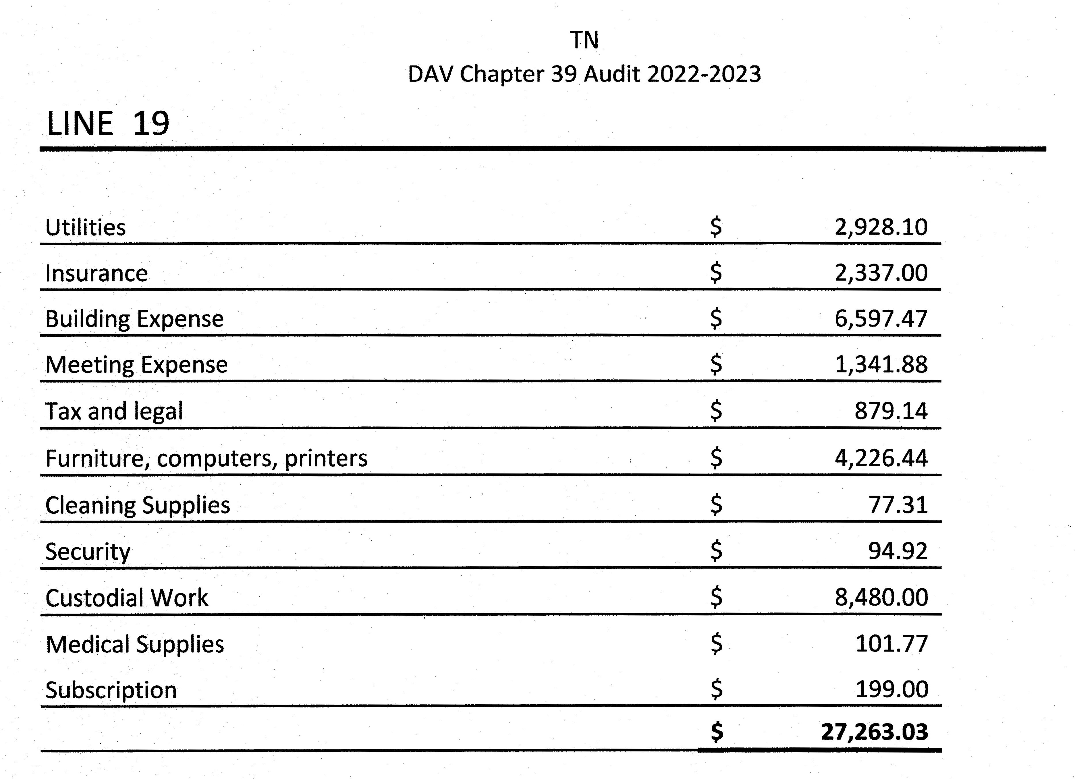
Annual Financial Report
AFR

Slide 40
Annual Financial Report
AFR
Line 20
Decrease in Market Value of
Investments on Line 26
Report any decrease in the market value of investments reported
on line 26 as of the end of the accounting period (June 30).

Slide 41
Annual Financial Report
AFR
Line 21 – Other Expenses
Report total amount of all other expenses that do not fit into any of the above categories.
Examples include: awards, gifts and pins to officers,
members and guests; dinners and picnics for the members;
installation, supplies (non-Forget-Me-Not) purchased from National,
and any other miscellaneous expenses.
Attach required schedule that clearly identifies the reason for the
disbursement with the total amount stated for each category.
NOTE: Depreciation of fixed assets (real estate, equipment, etc.) must
not be listed as an expense or disbursement on the financial report.
Transfers of funds (including cashing in and/or buying a CD) must not be listed on the
financial report.

Slide 42
Annual Financial Report
AFR
Only income
actually earned/received
and money
actually spent/ disbursed
during the accounting period
should be reported.

Slide 43
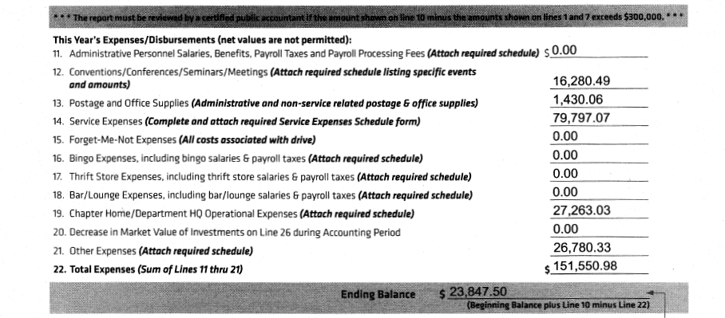
Annual Financial Report
AFR
Line 22
Total Expenses
The sum of lines 11 thru 21

Slide 44
Annual Financial Report
AFR
ENDING BALANCE FOR THIS YEAR’S REPORT
Ending Balance: This figure will be the amount listed on the
Beginning Balance line
of this current report
PLUS
the Total Income (line 10) and minus the Total Expenses (line 22),
which must agree with the Total Liquid Assets
listed on line 27 of this current report.

Slide 45
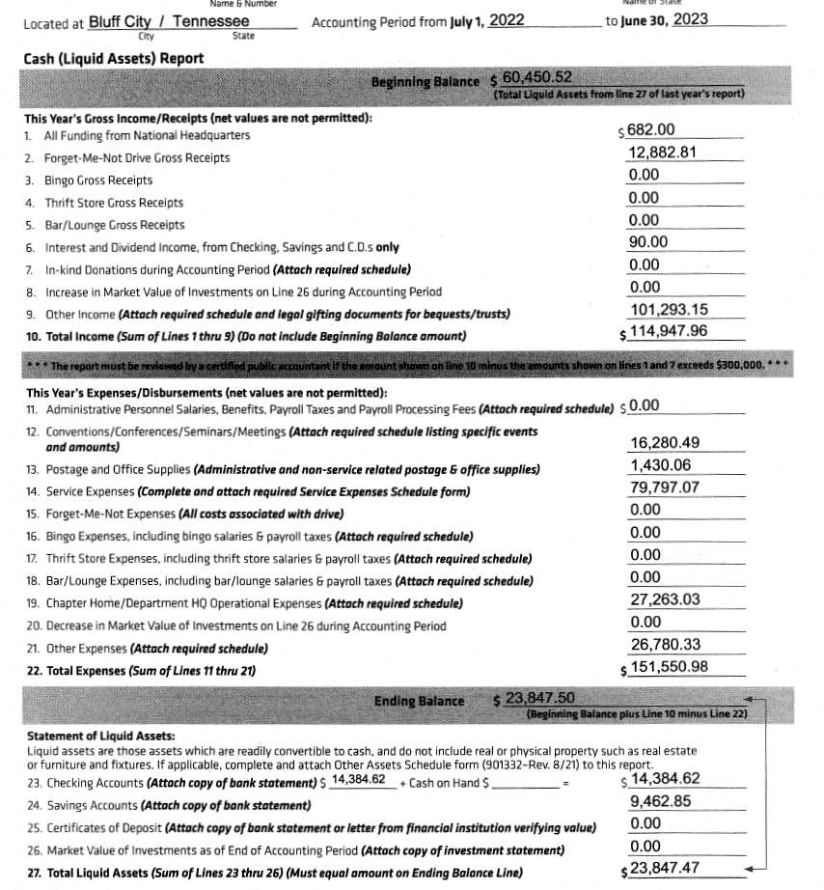
Annual Financial Report
AFR

Slide 46
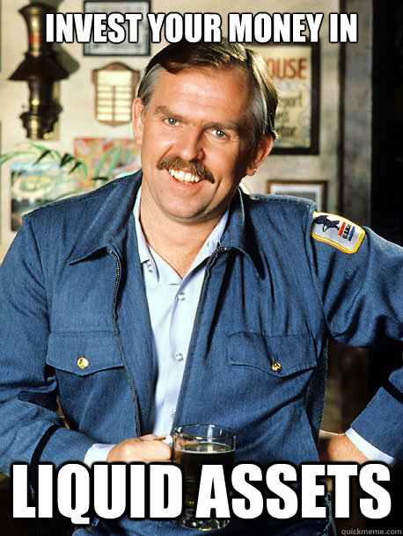
Annual Financial Report
AFR
Statement of Liquid Assets
Lines 23 thru 27 on this form are to be used to report only
liquid/cash assets which, for DAV’s financial reporting
purposes, are assets that are in cash form or are readily
convertible to cash
(i.e. stocks, bonds, mutual funds and any other securities).
Please remember that this does not include fixed assets such
as real estate, furniture/equipment, vehicles and
inventory/miscellaneous which must be reported on the
Other Assets Schedule form

Slide 47
Annual Financial Report
AFR
Line 23
Checking Accounts/Cash on Hand
Report total of amounts in all checking accounts on last day of accounting period (June 30).
Also report all cash on hand at that time. Attach a copy of ONLY the bank statement closest
to the ending date of the accounting period for each checking account.
NOTE: If the total amount reported on this line differs from the closing balance shown on the
bank statement(s) plus all cash on hand, provide a copy of the
reconciliation page for each checking account.

Slide 48
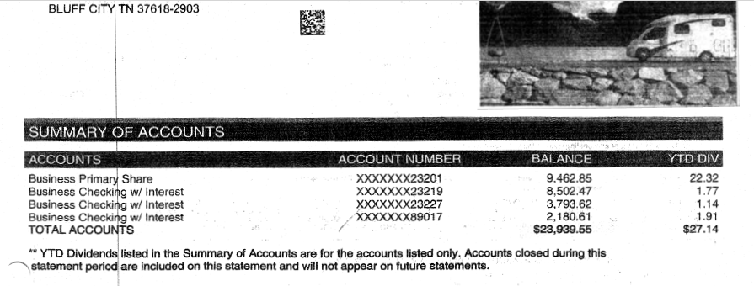
Annual Financial Report
AFR

Slide 49
Annual Financial Report
AFR

Slide 50
Annual Financial Report
AFR
Line 24
Savings Accounts
Report total of amounts in all savings accounts on last day of accounting period (June 30).
Attach a copy of ONLY the bank statement closest to the ending date of the accounting
period for each savings account.
NOTE: If the total amount reported on this line differs
from the closing balance shown on the bank statement(s), provide a copy of the
reconciliation page for each savings account.

Slide 51
Annual Financial Report
AFR

Slide 52
Annual Financial Report
AFR

Slide 53
Annual Financial Report
AFR
Line 25
Certificates of Deposit
Report total value (not original purchase value) of all certificates of deposit (CD) on last
day of accounting period (June 30). Attach a copy of ONLY the bank statement closest to
the ending date of the accounting period or a letter from the financial institution(s)
holding any CDs verifying the value as of the end of the accounting period for each CD.
NOTE: Be sure to properly report all CD interest earned during the accounting period on
line 6 and the actual total value of all CDs on the last day of the accounting period
on line 25.

Slide 54
Annual Financial Report
AFR
Line 26
Market Value of Investments as of
End of Accounting Period
Report total market value of investments on the last day of accounting period (June 30).
Attach a copy of ONLY the investment statement closest to the ending date of the
accounting period for all investments
(i.e. stocks, bonds, mutual funds and any other securities).

Slide 55
Annual Financial Report
AFR
Line 27
Total Liquid Assets
The sum of lines 23 thru 26. In all cases, this figure must equal the amount reported on the Ending Balance line.

Slide 56
Annual Financial Report
AFR

Slide 57
Annual Financial Report
AFR
Reports that are not in balance will not be accepted!

Slide 58
Annual Financial Report
AFR

Slide 59
Form 990 Overview Course

Slide 61
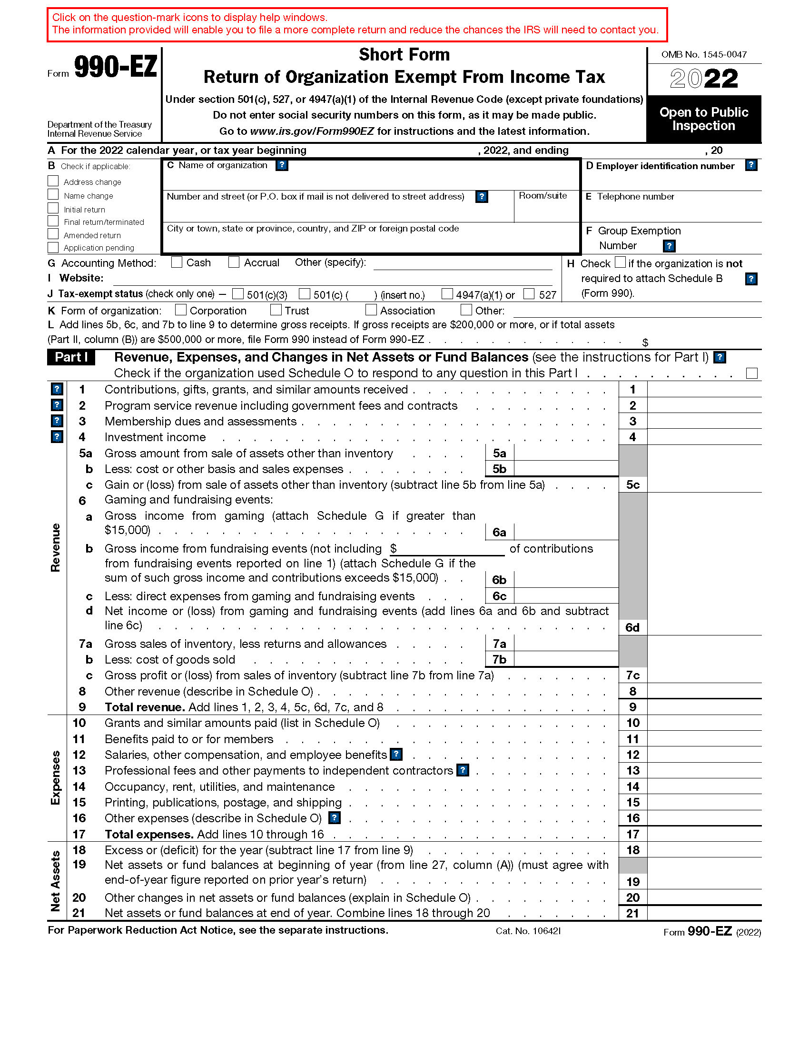

Slide 62
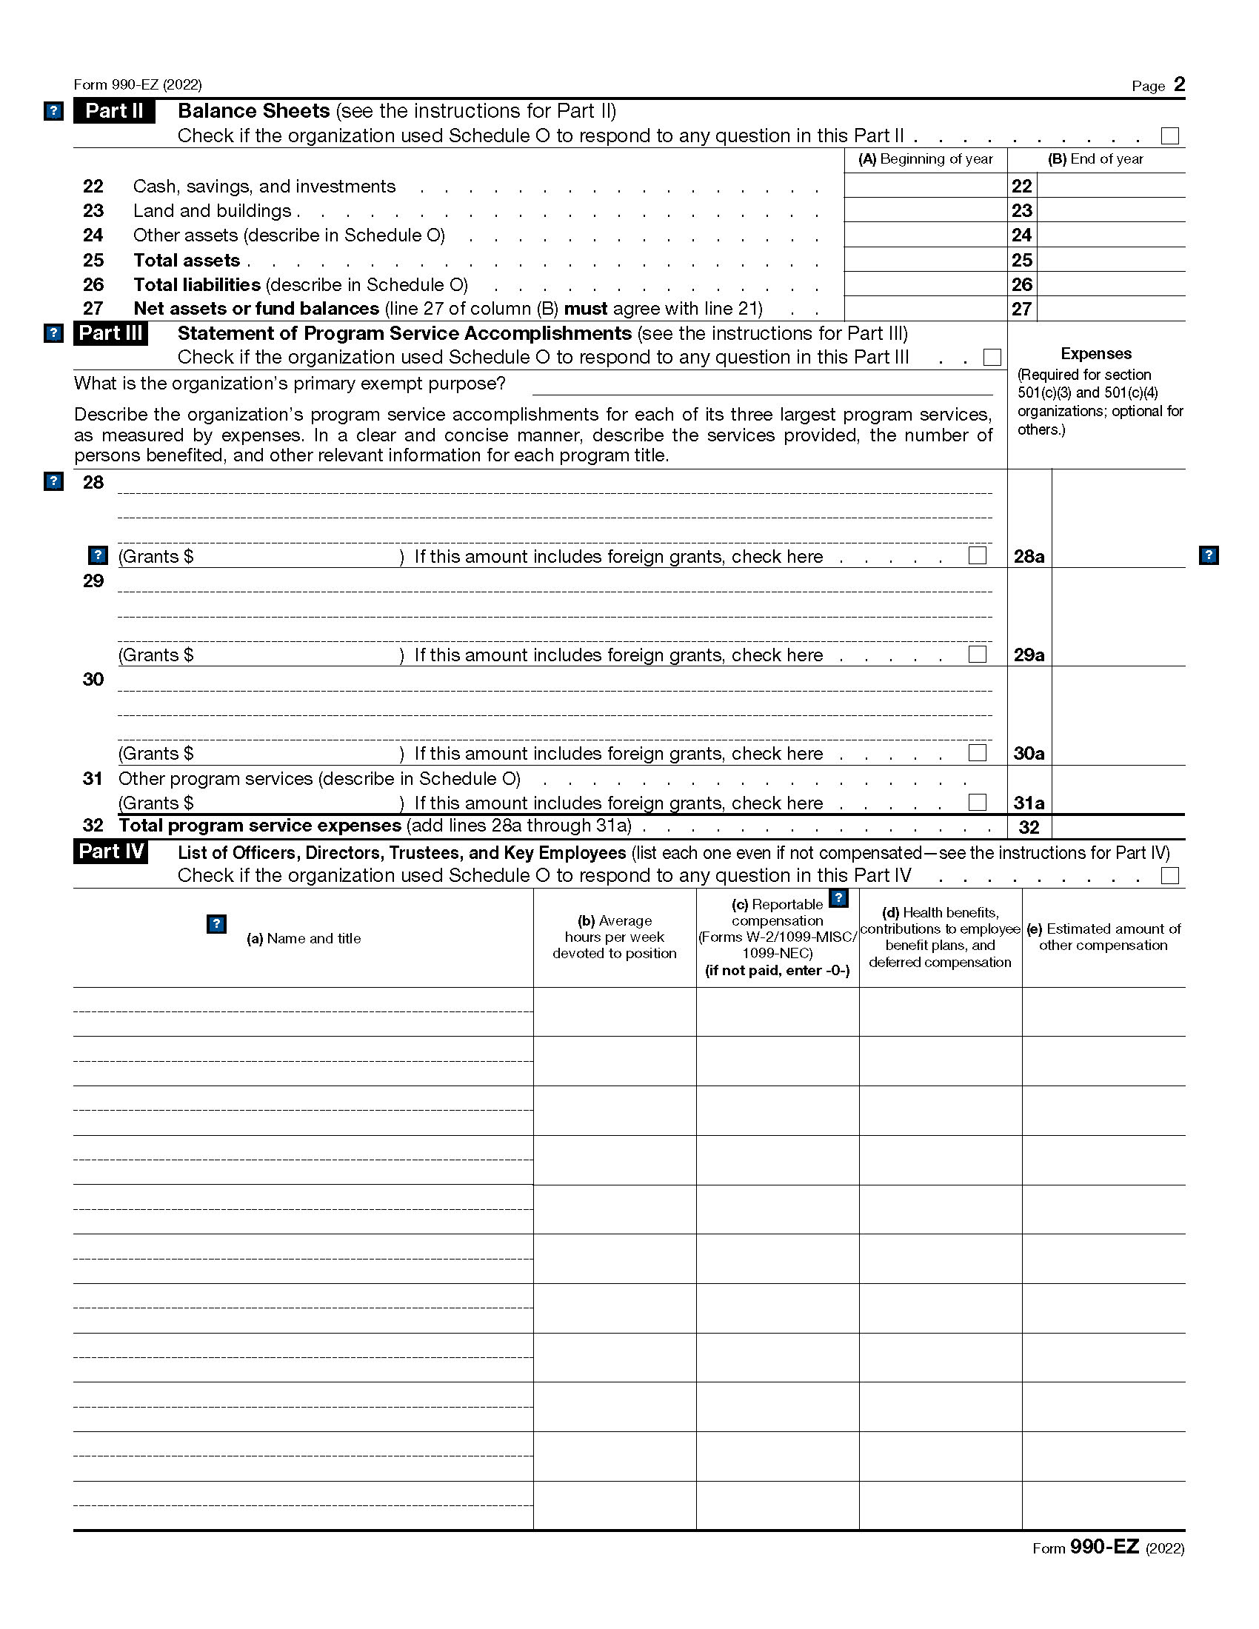

Slide 63
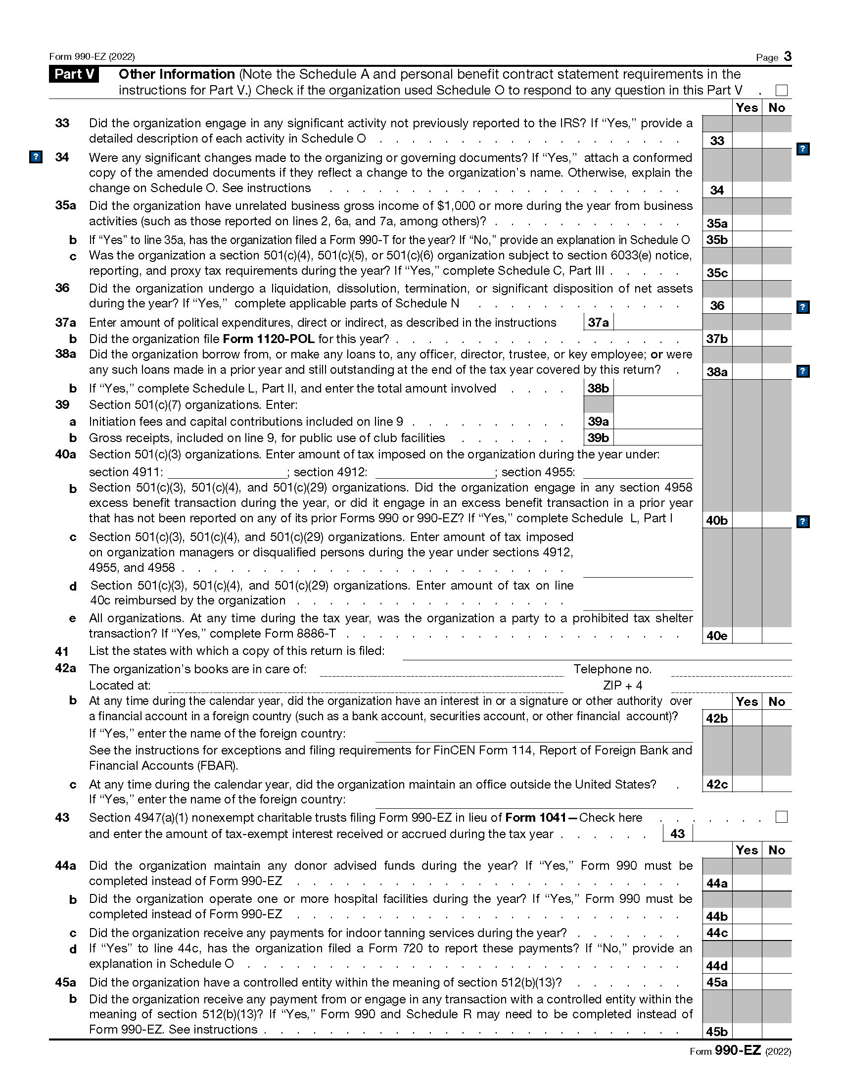

Slide 64
