Slide 1

Department and Chapter Service Officer Certification Training Program
- Level II -
Notes:
Introduction:
When I was appointed Director the Communications Department, I understood that part of my job responsibility was to address some tough questions.
We’ve had many successful campaigns and outreach, but a couple of years ago we saw the writing on the wall and understood that as an organization there was a critical need to evolve and grow in order to meet the challenges of the next century of service.
It’s not easy to ask:
Why isn’t there more awareness about DAV among the voter population?
How can DAV become more relevant to the young generation of vets and their families?
How can we grow our membership while we continue to serve our existing members well?
This brand revitalization is a direct result of our understanding that DAV must continue to be the premier VSO in the country.
I’d like to walk you through our branding process, answer your questions and share with you the path forward.

Slide 2


Welcome and Introductions
Notes:
We must continue to serve the men and women who know DAV, our members and the veterans we serve.
And, it’s also our responsibility to reach out and make ourselves known to the disabled American veterans who don’t know the breadth of DAV services so they are in a better position to regain their sense of normalcy and live a life with dignity and respect.
Ensuring the effectiveness of our outreach was a key motivation for recent research.
We all know the importance of remaining relevant and reaching out to the millions of veterans returning from Iraq & Afghanistan and continue to stay “present” for the many thousands already here.
*Note: Dan, we think that using injured instead of disabled at the beginning of the presentation might create some culture shock. We move to that language further into the ppt.

Slide 3
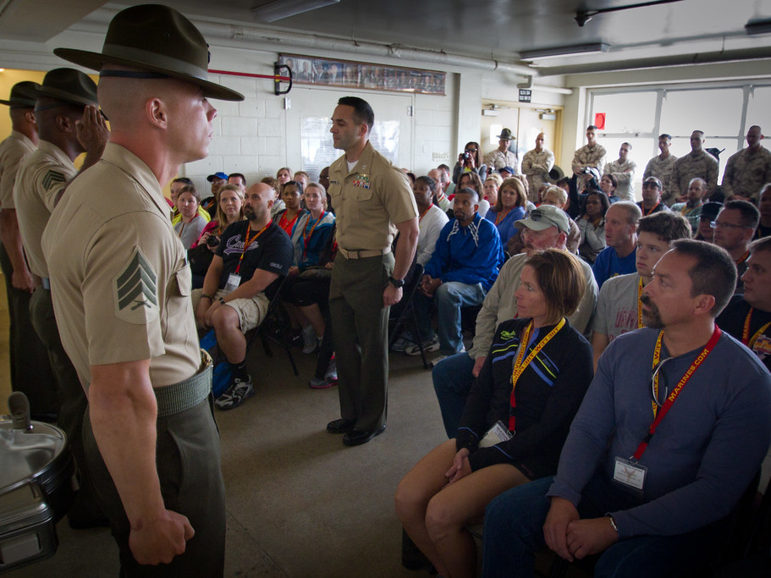
Instructor
Donald Samuels Jr
This Photo by Unknown Author is licensed under CC BY

Slide 4



Slide 5
DSO-CSO Level II Training
Mission & Purpose of DSO-CSO
To gather information to assist in obtaining benefits and services available to veterans, their dependents and survivors.
To advise and direct claimants
To forward all communication and information to the DAV National Service Office of jurisdiction
Page 53 Training Guide
Notes:
We must continue to serve the men and women who know DAV, our members and the veterans we serve.
And, it’s also our responsibility to reach out and make ourselves known to the disabled American veterans who don’t know the breadth of DAV services so they are in a better position to regain their sense of normalcy and live a life with dignity and respect.
Ensuring the effectiveness of our outreach was a key motivation for recent research.
We all know the importance of remaining relevant and reaching out to the millions of veterans returning from Iraq & Afghanistan and continue to stay “present” for the many thousands already here.
*Note: Dan, we think that using injured instead of disabled at the beginning of the presentation might create some culture shock. We move to that language further into the ppt.

Slide 6
DSO-CSO Level II Training
Certification: Scope and Definition
Certification means that DSOs-CSOs are covered by DAV’s liability insurance.
  Requires annual training and certification
  Ensures that claimants receive accurate VA benefits assistance and information
  Accredited Representatives (NSOs) have received accreditation by the VA
Page 53 Training Guide
Notes:
We must continue to serve the men and women who know DAV, our members and the veterans we serve.
And, it’s also our responsibility to reach out and make ourselves known to the disabled American veterans who don’t know the breadth of DAV services so they are in a better position to regain their sense of normalcy and live a life with dignity and respect.
Ensuring the effectiveness of our outreach was a key motivation for recent research.
We all know the importance of remaining relevant and reaching out to the millions of veterans returning from Iraq & Afghanistan and continue to stay “present” for the many thousands already here.
*Note: Dan, we think that using injured instead of disabled at the beginning of the presentation might create some culture shock. We move to that language further into the ppt.

Slide 7
DSO-CSO Level II Training
The Legal Environment of Claims-Related Service Work Publication
Maintaining Privacy
Ethics of Conduct
  You may not accept gifts, money, or favors for any services provided as a DSO or CSO
  You are personally liable for any misconduct not in compliance with DAV policies and claims-related service standards
Page 57 Training Guide
Notes:
We must continue to serve the men and women who know DAV, our members and the veterans we serve.
And, it’s also our responsibility to reach out and make ourselves known to the disabled American veterans who don’t know the breadth of DAV services so they are in a better position to regain their sense of normalcy and live a life with dignity and respect.
Ensuring the effectiveness of our outreach was a key motivation for recent research.
We all know the importance of remaining relevant and reaching out to the millions of veterans returning from Iraq & Afghanistan and continue to stay “present” for the many thousands already here.
*Note: Dan, we think that using injured instead of disabled at the beginning of the presentation might create some culture shock. We move to that language further into the ppt.

Slide 8
DSO-CSO Level II Training
DAV Representation
VA Form 21-22: Appointment of Veterans Service Organization as Claimant’s Representative(POA)- We will Review the POA in a few slides.
Proper Completion: The form has changed.
Page 67 Training Guide
Notes:
We must continue to serve the men and women who know DAV, our members and the veterans we serve.
And, it’s also our responsibility to reach out and make ourselves known to the disabled American veterans who don’t know the breadth of DAV services so they are in a better position to regain their sense of normalcy and live a life with dignity and respect.
Ensuring the effectiveness of our outreach was a key motivation for recent research.
We all know the importance of remaining relevant and reaching out to the millions of veterans returning from Iraq & Afghanistan and continue to stay “present” for the many thousands already here.
*Note: Dan, we think that using injured instead of disabled at the beginning of the presentation might create some culture shock. We move to that language further into the ppt.

Slide 9
DSO-CSO Level II Training
DAV Representation
DAV cannot represent a claimant if there are any limitations of consent in block 20.
If POA is taken and a claim is not filed (Ex. VA Form 21-526EZ) an Intent to File (ITF) VA Form 21-0966 (WILL) be completed.
An Intent to File provides one year for the claimant to formalize the claim. This provides protection for the veteran and will not create a liability for the DAV.
( New claims, Increased evaluation claims, Supplemental claims)
Page 67 Training Guide
Notes:
We must continue to serve the men and women who know DAV, our members and the veterans we serve.
And, it’s also our responsibility to reach out and make ourselves known to the disabled American veterans who don’t know the breadth of DAV services so they are in a better position to regain their sense of normalcy and live a life with dignity and respect.
Ensuring the effectiveness of our outreach was a key motivation for recent research.
We all know the importance of remaining relevant and reaching out to the millions of veterans returning from Iraq & Afghanistan and continue to stay “present” for the many thousands already here.
*Note: Dan, we think that using injured instead of disabled at the beginning of the presentation might create some culture shock. We move to that language further into the ppt.

Slide 10
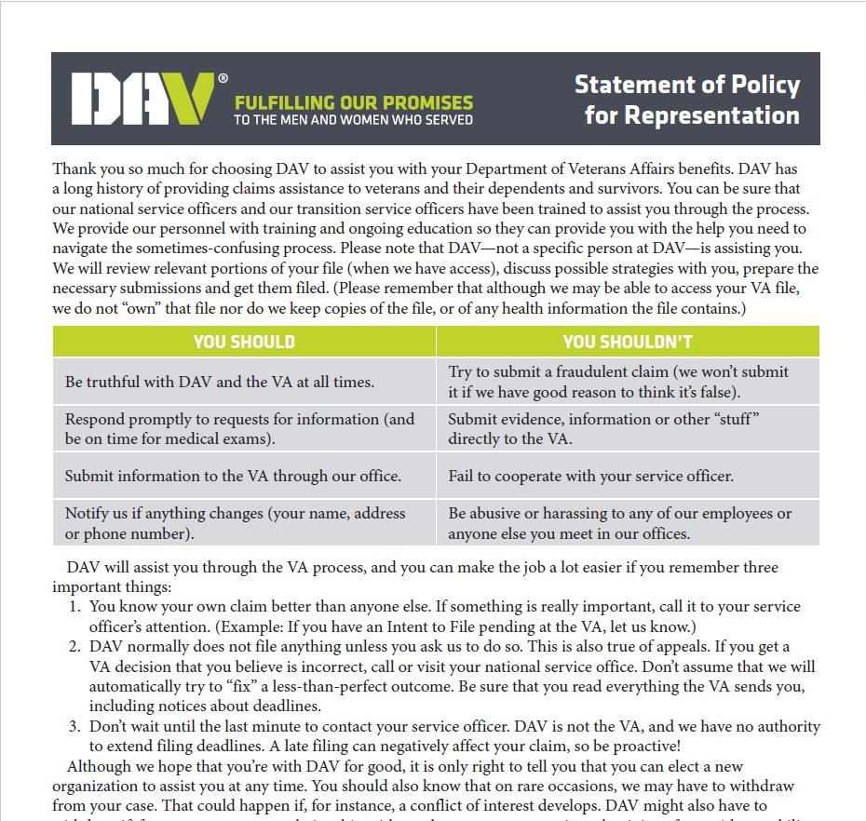

Slide 11
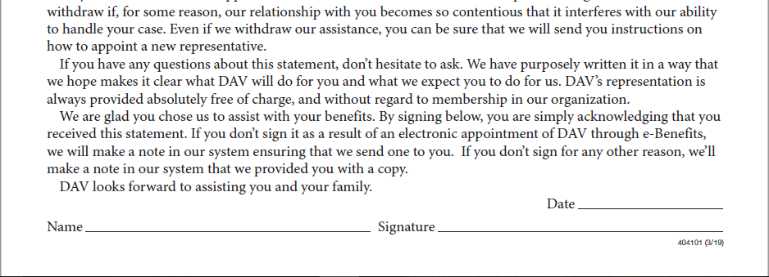

Slide 12
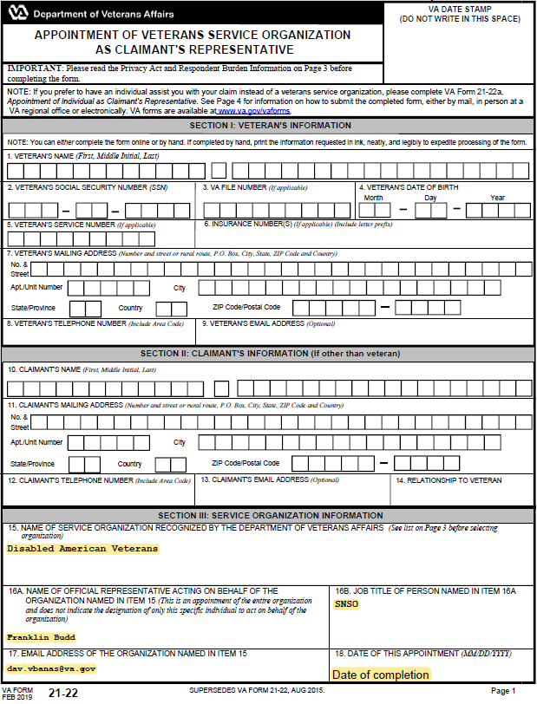

Slide 13
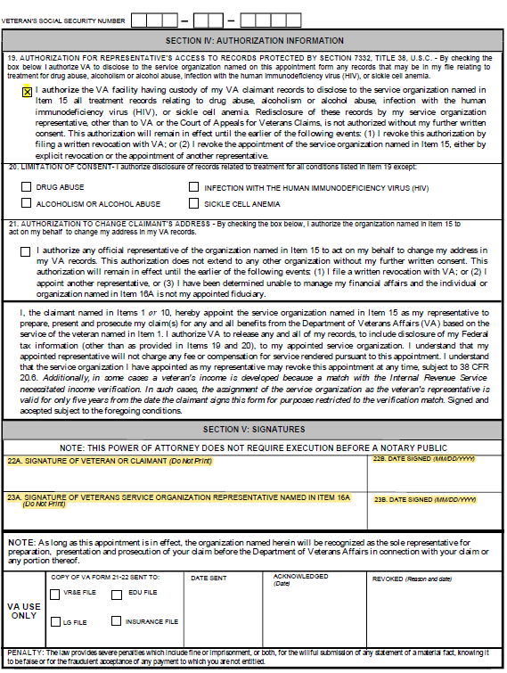

Slide 14

DSO-CSO Level II Training
Principles of Service Connection
Notes:
We must continue to serve the men and women who know DAV, our members and the veterans we serve.
And, it’s also our responsibility to reach out and make ourselves known to the disabled American veterans who don’t know the breadth of DAV services so they are in a better position to regain their sense of normalcy and live a life with dignity and respect.
Ensuring the effectiveness of our outreach was a key motivation for recent research.
We all know the importance of remaining relevant and reaching out to the millions of veterans returning from Iraq & Afghanistan and continue to stay “present” for the many thousands already here.
*Note: Dan, we think that using injured instead of disabled at the beginning of the presentation might create some culture shock. We move to that language further into the ppt.

Slide 15

7 Ways to Service Connection

Slide 16
VA forms
21-526EZ, 21P-527EZ and 21P-534EZ describe the evidence needed to prove certain claims, and therefore fulfill the VA’s Duty to Notify requirements.

Slide 17
Surviving Spouse Claim
A surviving spouse must apply for death benefits on VA form 21P-534EZ.

Slide 18
DSO-CSO Level II Training
Direct Service Connection
38 C.F.R. 3.304 Direct Service Connection
  Requires 3 elements:
    ➢ Injury or disease that was incurred in service that is noted in service treatment records
    ➢ A current diagnosis
    ➢ A medical opinion (Nexus) linking the current diagnosis to military service
Notes:
We must continue to serve the men and women who know DAV, our members and the veterans we serve.
And, it’s also our responsibility to reach out and make ourselves known to the disabled American veterans who don’t know the breadth of DAV services so they are in a better position to regain their sense of normalcy and live a life with dignity and respect.
Ensuring the effectiveness of our outreach was a key motivation for recent research.
We all know the importance of remaining relevant and reaching out to the millions of veterans returning from Iraq & Afghanistan and continue to stay “present” for the many thousands already here.
*Note: Dan, we think that using injured instead of disabled at the beginning of the presentation might create some culture shock. We move to that language further into the ppt.

Slide 19
DSO-CSO Level II Training
Aggravation of Preservice Disability
  38 C.F.R. 3.306 A preexisting injury or disease will be considered to have been aggravated by active military, naval, or air service, where there is an increase in disability during such service, unless there is a specific finding that the increase in disability is due to the natural progress of the disease.
Notes:
We must continue to serve the men and women who know DAV, our members and the veterans we serve.
And, it’s also our responsibility to reach out and make ourselves known to the disabled American veterans who don’t know the breadth of DAV services so they are in a better position to regain their sense of normalcy and live a life with dignity and respect.
Ensuring the effectiveness of our outreach was a key motivation for recent research.
We all know the importance of remaining relevant and reaching out to the millions of veterans returning from Iraq & Afghanistan and continue to stay “present” for the many thousands already here.
*Note: Dan, we think that using injured instead of disabled at the beginning of the presentation might create some culture shock. We move to that language further into the ppt.

Slide 20
DSO-CSO Level II Training
Aggravation of Preservice Disability
  Clarification
  Just because an injury or disease worsened during military service, does not mean that it should be service connected. It has to show that the increase in disability was not due to the natural progression of the disease.
Notes:
We must continue to serve the men and women who know DAV, our members and the veterans we serve.
And, it’s also our responsibility to reach out and make ourselves known to the disabled American veterans who don’t know the breadth of DAV services so they are in a better position to regain their sense of normalcy and live a life with dignity and respect.
Ensuring the effectiveness of our outreach was a key motivation for recent research.
We all know the importance of remaining relevant and reaching out to the millions of veterans returning from Iraq & Afghanistan and continue to stay “present” for the many thousands already here.
*Note: Dan, we think that using injured instead of disabled at the beginning of the presentation might create some culture shock. We move to that language further into the ppt.

Slide 21
DSO-CSO Level II Training
Presumptive Service Connection
  The basic requirements and explanations for presumptive service connection can be found at 38 CFR 3.307.
  38 CFR 3.309 is a List of Diseases
    Chronic Diseases (within 12 months)
    Tropical Diseases
    Former POWs
    Herbicides (Currently, boots on ground or brown water service)
    The list of diseases associated with Agent Orange exposure is growing again.
    The U.S. Department of Veterans Affairs has added three diseases to the presumptive list: Parkinsonism, bladder cancer, and hypothyroidism.
Pages 93-98 Training Guide
Notes:
We must continue to serve the men and women who know DAV, our members and the veterans we serve.
And, it’s also our responsibility to reach out and make ourselves known to the disabled American veterans who don’t know the breadth of DAV services so they are in a better position to regain their sense of normalcy and live a life with dignity and respect.
Ensuring the effectiveness of our outreach was a key motivation for recent research.
We all know the importance of remaining relevant and reaching out to the millions of veterans returning from Iraq & Afghanistan and continue to stay “present” for the many thousands already here.
*Note: Dan, we think that using injured instead of disabled at the beginning of the presentation might create some culture shock. We move to that language further into the ppt.

Slide 22
New Presumptive’ s
The VA announced it will begin processing claims for the chronic disabilities of asthma, rhinitis, and sinusitis, to include rhinosinusitis, as of Aug. 5, with servicemembers who deployed in Southwest Asia during the Gulf War and in response to the Global War on Terror eligible to have their claims fast-tracked.
Servicemembers whose conditions manifested and diagnosed within 10 years of qualifying service, are eligible to have their claims fast-tracked by the VA if they served:
In the Southwest Asia theater of operations beginning Aug. 2, 1990, to the present (to include Iraq, Kuwait, Saudi Arabia, the neutral zone between Iraq and Saudi Arabia, Bahrain, Qatar, the United Arab Emirates, Oman, the Gulf of Aden, the Gulf of Oman, the Persian Gulf, the Arabian Sea, the Red Sea and the airspace above these locations), or
In Afghanistan, Uzbekistan, Syria, or Djibouti beginning Sept. 19, 2001, to the present.

Slide 23
DSO-CSO Level II Training
Presumptive Service Connection
  Service connection can be granted on the basis of presumption for chronic, tropical or prisoner-of-war related diseases, incurred during wartime and service after January 1, 1947.
Pages 93-98 Training Guide
Notes:
We must continue to serve the men and women who know DAV, our members and the veterans we serve.
And, it’s also our responsibility to reach out and make ourselves known to the disabled American veterans who don’t know the breadth of DAV services so they are in a better position to regain their sense of normalcy and live a life with dignity and respect.
Ensuring the effectiveness of our outreach was a key motivation for recent research.
We all know the importance of remaining relevant and reaching out to the millions of veterans returning from Iraq & Afghanistan and continue to stay “present” for the many thousands already here.
*Note: Dan, we think that using injured instead of disabled at the beginning of the presentation might create some culture shock. We move to that language further into the ppt.

Slide 24
DSO-CSO Level II Training
Presumptive Service Connection
  Compensation for certain disabilities occurring in Persian Gulf veterans. (Undiagnosed Illnesses and Infectious Diseases) 38 CFR 3.317 (IBS) Irritable Bowel Syndrome. Structural and functional.
  (fibromyalgia) (Chronic Fatigue)
  Presumptive service connection for amyotrophic lateral sclerosis for all Veterans (ALS or Lou Gehrig's Disease). 38 CFR 3.318
Pages 99-101 Training Guide
Notes:
We must continue to serve the men and women who know DAV, our members and the veterans we serve.
And, it’s also our responsibility to reach out and make ourselves known to the disabled American veterans who don’t know the breadth of DAV services so they are in a better position to regain their sense of normalcy and live a life with dignity and respect.
Ensuring the effectiveness of our outreach was a key motivation for recent research.
We all know the importance of remaining relevant and reaching out to the millions of veterans returning from Iraq & Afghanistan and continue to stay “present” for the many thousands already here.
*Note: Dan, we think that using injured instead of disabled at the beginning of the presentation might create some culture shock. We move to that language further into the ppt.

Slide 25
DSO-CSO Level II Training
Presumptive Service Connection
Basic Requirements:
  Confirmed exposure to whatever presumptive that the veteran is filing exposure to:
    VA will confirm the exposure through the veterans Service Personnel Records and through the Branch of Service.
  2. Confirmed diagnosis of a presumptive condition that is on the presumptive list for that specific exposure.
Notes:
We must continue to serve the men and women who know DAV, our members and the veterans we serve.
And, it’s also our responsibility to reach out and make ourselves known to the disabled American veterans who don’t know the breadth of DAV services so they are in a better position to regain their sense of normalcy and live a life with dignity and respect.
Ensuring the effectiveness of our outreach was a key motivation for recent research.
We all know the importance of remaining relevant and reaching out to the millions of veterans returning from Iraq & Afghanistan and continue to stay “present” for the many thousands already here.
*Note: Dan, we think that using injured instead of disabled at the beginning of the presentation might create some culture shock. We move to that language further into the ppt.

Slide 26
DSO-CSO Level II Training
Secondary Service- Connected Disabilities
  38 CFR 3.310 Disabilities that are proximately due to, or aggravated by, service-connected disease or injury can be service connected.
  ➢ Have a Service Connected Disability
  ➢ Current Diagnosis (Condition)
  ➢ A medical opinion linking the current diagnosis to the service connected disability
Page 97 Training Guide
Notes:
We must continue to serve the men and women who know DAV, our members and the veterans we serve.
And, it’s also our responsibility to reach out and make ourselves known to the disabled American veterans who don’t know the breadth of DAV services so they are in a better position to regain their sense of normalcy and live a life with dignity and respect.
Ensuring the effectiveness of our outreach was a key motivation for recent research.
We all know the importance of remaining relevant and reaching out to the millions of veterans returning from Iraq & Afghanistan and continue to stay “present” for the many thousands already here.
*Note: Dan, we think that using injured instead of disabled at the beginning of the presentation might create some culture shock. We move to that language further into the ppt.

Slide 27
DSO-CSO Level II Training
Secondary Service-Connected Disabilities
  38 CFR 3.310(c) Cardiovascular disease.
  Ischemic heart disease or other cardiovascular disease developing in a veteran who has a service-connected amputation of one lower extremity at or above the knee or service-connected amputations of both lower extremities at or above the ankles, shall be held to be the proximate result of the service-connected amputation or amputations.
Page 97 Training Guide
Notes:
We must continue to serve the men and women who know DAV, our members and the veterans we serve.
And, it’s also our responsibility to reach out and make ourselves known to the disabled American veterans who don’t know the breadth of DAV services so they are in a better position to regain their sense of normalcy and live a life with dignity and respect.
Ensuring the effectiveness of our outreach was a key motivation for recent research.
We all know the importance of remaining relevant and reaching out to the millions of veterans returning from Iraq & Afghanistan and continue to stay “present” for the many thousands already here.
*Note: Dan, we think that using injured instead of disabled at the beginning of the presentation might create some culture shock. We move to that language further into the ppt.

Slide 28
DSO-CSO Level II Training
Disability Due to VA Hospital Care or
VA Treatment (1151)
  If it is determined that there is additional disability resulting from a disease or injury or aggravation of an existing disease or injury suffered as a result of hospitalization, medical or surgical treatment, or examination, compensation will be payable for such additional disability. 38 CFR 3.361
Page 105 Training Guide
Notes:
We must continue to serve the men and women who know DAV, our members and the veterans we serve.
And, it’s also our responsibility to reach out and make ourselves known to the disabled American veterans who don’t know the breadth of DAV services so they are in a better position to regain their sense of normalcy and live a life with dignity and respect.
Ensuring the effectiveness of our outreach was a key motivation for recent research.
We all know the importance of remaining relevant and reaching out to the millions of veterans returning from Iraq & Afghanistan and continue to stay “present” for the many thousands already here.
*Note: Dan, we think that using injured instead of disabled at the beginning of the presentation might create some culture shock. We move to that language further into the ppt.

Slide 29
DSO-CSO Level II Training
Disability Due to Training and Rehabilitation Services, or Compensated Work Therapy (CWT) program
  To establish that the provision of training and rehabilitation services or a CWT program proximately caused a veteran's additional disability or death, it must be shown that the veteran's participation in an essential activity or function of the training, services, or CWT program provided or authorized by VA proximately caused the disability or death. 38 CFR 3.361(VR&E) Vocational Rehabilitation
Page 105 Training Guide
Notes:
We must continue to serve the men and women who know DAV, our members and the veterans we serve.
And, it’s also our responsibility to reach out and make ourselves known to the disabled American veterans who don’t know the breadth of DAV services so they are in a better position to regain their sense of normalcy and live a life with dignity and respect.
Ensuring the effectiveness of our outreach was a key motivation for recent research.
We all know the importance of remaining relevant and reaching out to the millions of veterans returning from Iraq & Afghanistan and continue to stay “present” for the many thousands already here.
*Note: Dan, we think that using injured instead of disabled at the beginning of the presentation might create some culture shock. We move to that language further into the ppt.

Slide 30
DSO-CSO Level II Training
Paired organs and extremities
Compensation is payable for the combinations of service-connected and nonservice-connected disabilities, as if both disabilities were service-connected, provided the nonservice-connected disability is not the result of the veteran's own willful misconduct. 38 CFR 3.383
  Impairment of vision in one eye as a result of service-connected disability and impairment of vision in the other eye as a result of non-service-connected disability,
Notes:
We must continue to serve the men and women who know DAV, our members and the veterans we serve.
And, it’s also our responsibility to reach out and make ourselves known to the disabled American veterans who don’t know the breadth of DAV services so they are in a better position to regain their sense of normalcy and live a life with dignity and respect.
Ensuring the effectiveness of our outreach was a key motivation for recent research.
We all know the importance of remaining relevant and reaching out to the millions of veterans returning from Iraq & Afghanistan and continue to stay “present” for the many thousands already here.
*Note: Dan, we think that using injured instead of disabled at the beginning of the presentation might create some culture shock. We move to that language further into the ppt.

Slide 31
DSO-CSO Level II Training
Paired organs and extremities Contd.
  Loss or loss of use of one kidney as a result of service-connected disability and involvement of the other kidney as a result of nonservice-connected disability.
  Hearing impairment in one ear compensable to a degree of 10 percent or more, service-connected, and hearing impairment (NSC) in the other ear, that meets the provisions of §3.385 in the other ear.
Notes:
We must continue to serve the men and women who know DAV, our members and the veterans we serve.
And, it’s also our responsibility to reach out and make ourselves known to the disabled American veterans who don’t know the breadth of DAV services so they are in a better position to regain their sense of normalcy and live a life with dignity and respect.
Ensuring the effectiveness of our outreach was a key motivation for recent research.
We all know the importance of remaining relevant and reaching out to the millions of veterans returning from Iraq & Afghanistan and continue to stay “present” for the many thousands already here.
*Note: Dan, we think that using injured instead of disabled at the beginning of the presentation might create some culture shock. We move to that language further into the ppt.

Slide 32
DSO-CSO Level II Training
Paired organs and extremities Contd.
  Loss or loss of use of one hand or one foot as a result of service-connected disability and loss or loss of use of the other hand or foot as a result of nonservice-connected disability.
  Permanent service-connected disability of one lung, rated 50 percent or more disabling, in combination with a nonservice-connected disability of the other lung.
Notes:
We must continue to serve the men and women who know DAV, our members and the veterans we serve.
And, it’s also our responsibility to reach out and make ourselves known to the disabled American veterans who don’t know the breadth of DAV services so they are in a better position to regain their sense of normalcy and live a life with dignity and respect.
Ensuring the effectiveness of our outreach was a key motivation for recent research.
We all know the importance of remaining relevant and reaching out to the millions of veterans returning from Iraq & Afghanistan and continue to stay “present” for the many thousands already here.
*Note: Dan, we think that using injured instead of disabled at the beginning of the presentation might create some culture shock. We move to that language further into the ppt.

Slide 33

DSO-CSO Level II Training
Claims Process Basics
(Evidence, Effective Dates, Keys to Service Connection)
Notes:
We must continue to serve the men and women who know DAV, our members and the veterans we serve.
And, it’s also our responsibility to reach out and make ourselves known to the disabled American veterans who don’t know the breadth of DAV services so they are in a better position to regain their sense of normalcy and live a life with dignity and respect.
Ensuring the effectiveness of our outreach was a key motivation for recent research.
We all know the importance of remaining relevant and reaching out to the millions of veterans returning from Iraq & Afghanistan and continue to stay “present” for the many thousands already here.
*Note: Dan, we think that using injured instead of disabled at the beginning of the presentation might create some culture shock. We move to that language further into the ppt.

Slide 34
DSO-CSO Level II Training
Claims Process
  DSO-CSO Meets with Claimant to file Claim
  DSC-CSO submits claim to NSO Office
  NSO reviews claims and submits to VA
  VA receives claim and establishes claim in tracking systems
  Development
    DTA
    VA examinations (Not all claims)
What To Expect After Filing a VA Claim
Notes:
We must continue to serve the men and women who know DAV, our members and the veterans we serve.
And, it’s also our responsibility to reach out and make ourselves known to the disabled American veterans who don’t know the breadth of DAV services so they are in a better position to regain their sense of normalcy and live a life with dignity and respect.
Ensuring the effectiveness of our outreach was a key motivation for recent research.
We all know the importance of remaining relevant and reaching out to the millions of veterans returning from Iraq & Afghanistan and continue to stay “present” for the many thousands already here.
*Note: Dan, we think that using injured instead of disabled at the beginning of the presentation might create some culture shock. We move to that language further into the ppt.

Slide 35

But It WILL………….

Slide 36
DSO-CSO Level II Training
Claims Process
  DSO-CSO Meets with Claimant to file Claim (ITFs with all POA’s)
  DSO-CSO submits claim to NSO Office
  NSO reviews claims and submits to VA
  VA receives claim and establishes claim in tracking systems
  Development
    Duty to Assist- 526EZ Contains DTA
    VA examinations (Not all claims)
Page 69 Training Guide
Notes:
We must continue to serve the men and women who know DAV, our members and the veterans we serve.
And, it’s also our responsibility to reach out and make ourselves known to the disabled American veterans who don’t know the breadth of DAV services so they are in a better position to regain their sense of normalcy and live a life with dignity and respect.
Ensuring the effectiveness of our outreach was a key motivation for recent research.
We all know the importance of remaining relevant and reaching out to the millions of veterans returning from Iraq & Afghanistan and continue to stay “present” for the many thousands already here.
*Note: Dan, we think that using injured instead of disabled at the beginning of the presentation might create some culture shock. We move to that language further into the ppt.

Slide 37
DSO-CSO Level II Training
Claims Process
  VA completes all development, claim then goes to Rating Veteran Service Representative (RVSR)
  RVSR renders decision and the decision is reviewed by an NSO (In Most Cases)
  VA notifies claimant in writing
  Any monetary benefits are paid to claimant
Page 69 Training Guide
Notes:
We must continue to serve the men and women who know DAV, our members and the veterans we serve.
And, it’s also our responsibility to reach out and make ourselves known to the disabled American veterans who don’t know the breadth of DAV services so they are in a better position to regain their sense of normalcy and live a life with dignity and respect.
Ensuring the effectiveness of our outreach was a key motivation for recent research.
We all know the importance of remaining relevant and reaching out to the millions of veterans returning from Iraq & Afghanistan and continue to stay “present” for the many thousands already here.
*Note: Dan, we think that using injured instead of disabled at the beginning of the presentation might create some culture shock. We move to that language further into the ppt.

Slide 38
DSO-CSO Level II Training
Assisting in the Claims Process
Types of Evidence Helpful for Claims
  Medical Treatment Reports
  Disability Questionnaires (DBQ)
  Physician Statements
  Lay Statements
  Service Records
Page 70 Training Guide
Notes:
We must continue to serve the men and women who know DAV, our members and the veterans we serve.
And, it’s also our responsibility to reach out and make ourselves known to the disabled American veterans who don’t know the breadth of DAV services so they are in a better position to regain their sense of normalcy and live a life with dignity and respect.
Ensuring the effectiveness of our outreach was a key motivation for recent research.
We all know the importance of remaining relevant and reaching out to the millions of veterans returning from Iraq & Afghanistan and continue to stay “present” for the many thousands already here.
*Note: Dan, we think that using injured instead of disabled at the beginning of the presentation might create some culture shock. We move to that language further into the ppt.

Slide 39
DSO-CSO Level II Training
Effective Dates
Except as otherwise provided, the effective date of an evaluation and award of pension, compensation or dependency and indemnity compensation based on an original claim, a claim reopened after final disallowance, or a claim for increase will be the date of receipt of the claim or the date entitlement arose, whichever is the later. 38 CFR 3.400
Page 105 Training Guide
Notes:
We must continue to serve the men and women who know DAV, our members and the veterans we serve.
And, it’s also our responsibility to reach out and make ourselves known to the disabled American veterans who don’t know the breadth of DAV services so they are in a better position to regain their sense of normalcy and live a life with dignity and respect.
Ensuring the effectiveness of our outreach was a key motivation for recent research.
We all know the importance of remaining relevant and reaching out to the millions of veterans returning from Iraq & Afghanistan and continue to stay “present” for the many thousands already here.
*Note: Dan, we think that using injured instead of disabled at the beginning of the presentation might create some culture shock. We move to that language further into the ppt.

Slide 40
DSO-CSO Level II Training
Protection Rules
10 Years – Service Connection 38 CFR 3.957
Service connection for any disability or death granted or continued under title 38 U.S.C., which has been in effect for 10 or more years will not be severed except upon a showing that the original grant was based on fraud or it is clearly shown from military records that the person concerned did not have the requisite service or character of discharge.
*Cannot be severed after 10 years but can be reduced
Page 73 Training Guide
Notes:
We must continue to serve the men and women who know DAV, our members and the veterans we serve.
And, it’s also our responsibility to reach out and make ourselves known to the disabled American veterans who don’t know the breadth of DAV services so they are in a better position to regain their sense of normalcy and live a life with dignity and respect.
Ensuring the effectiveness of our outreach was a key motivation for recent research.
We all know the importance of remaining relevant and reaching out to the millions of veterans returning from Iraq & Afghanistan and continue to stay “present” for the many thousands already here.
*Note: Dan, we think that using injured instead of disabled at the beginning of the presentation might create some culture shock. We move to that language further into the ppt.

Slide 41
DSO-CSO Level II Training
Protection Rules
20 Years –Evaluation of Disability 38 CFR 3.951
A disability which has been continuously rated at or above any evaluation of disability for 20 or more years for compensation purposes under laws administered by the Department of Veterans Affairs will not be reduced to less than such evaluation except upon a showing that such rating was based on fraud.
Page 73 Training Guide
Notes:
We must continue to serve the men and women who know DAV, our members and the veterans we serve.
And, it’s also our responsibility to reach out and make ourselves known to the disabled American veterans who don’t know the breadth of DAV services so they are in a better position to regain their sense of normalcy and live a life with dignity and respect.
Ensuring the effectiveness of our outreach was a key motivation for recent research.
We all know the importance of remaining relevant and reaching out to the millions of veterans returning from Iraq & Afghanistan and continue to stay “present” for the many thousands already here.
*Note: Dan, we think that using injured instead of disabled at the beginning of the presentation might create some culture shock. We move to that language further into the ppt.

Slide 42
DSO-CSO Level II Training
Keys to Service Connection
Medical Opinions
  What in a medical opinion can be considered new and relevant evidence?
  Current diagnosis, summary of records reviewed
  Nexus or Link (medical opinion)
  Rationale on how the opinion is justified
Time Frames
  Within 1 year New and Relevant evidence can be used for readjudication
  You no longer file a re-adjudication, you would file a 20-0995 or 20-0996)
Notes:
We must continue to serve the men and women who know DAV, our members and the veterans we serve.
And, it’s also our responsibility to reach out and make ourselves known to the disabled American veterans who don’t know the breadth of DAV services so they are in a better position to regain their sense of normalcy and live a life with dignity and respect.
Ensuring the effectiveness of our outreach was a key motivation for recent research.
We all know the importance of remaining relevant and reaching out to the millions of veterans returning from Iraq & Afghanistan and continue to stay “present” for the many thousands already here.
*Note: Dan, we think that using injured instead of disabled at the beginning of the presentation might create some culture shock. We move to that language further into the ppt.

Slide 43


Slide 44

DSO-CSO Level II Training
Standardized Forms
& Fully Developed Claims
Notes:
We must continue to serve the men and women who know DAV, our members and the veterans we serve.
And, it’s also our responsibility to reach out and make ourselves known to the disabled American veterans who don’t know the breadth of DAV services so they are in a better position to regain their sense of normalcy and live a life with dignity and respect.
Ensuring the effectiveness of our outreach was a key motivation for recent research.
We all know the importance of remaining relevant and reaching out to the millions of veterans returning from Iraq & Afghanistan and continue to stay “present” for the many thousands already here.
*Note: Dan, we think that using injured instead of disabled at the beginning of the presentation might create some culture shock. We move to that language further into the ppt.

Slide 45
There are two rules to help you.
Rule One: When you are in doubt, file a power of attorney form.
What form number is that?
And an Intent to file.
What form number is that?
Rule Two: If you have questions call the NSO office. Call or email us at:
NSO office phone number (615-695-6384)
NSO office email dav.vbanas@va.gov

Slide 46
DSO-CSO Level II Training
Claims must be filed on Standardized Forms:
Compensation claims are required to be filed on VA Form 21-526EZ, Application for Disability Compensation and Related Compensation Benefits.
Pension claims must be filed on VA Form
21P-527EZ, Application for Pension.
Survivor’s claims must be filed on VA Form
21P-534EZ, Application for DIC, Death
Pension, and/or Accrued Benefits.
Page 70 Training Guide
Notes:
We must continue to serve the men and women who know DAV, our members and the veterans we serve.
And, it’s also our responsibility to reach out and make ourselves known to the disabled American veterans who don’t know the breadth of DAV services so they are in a better position to regain their sense of normalcy and live a life with dignity and respect.
Ensuring the effectiveness of our outreach was a key motivation for recent research.
We all know the importance of remaining relevant and reaching out to the millions of veterans returning from Iraq & Afghanistan and continue to stay “present” for the many thousands already here.
*Note: Dan, we think that using injured instead of disabled at the beginning of the presentation might create some culture shock. We move to that language further into the ppt.

Slide 47
DSO-CSO Level II Training
Fully Developed Claims
Inform Claimants they should only provide information to DAV, not directly the to VA.
Claimants should obtain all evidence, and then provide it with a completed EZ form.
Pages 69-70 Training Guide
Notes:
We must continue to serve the men and women who know DAV, our members and the veterans we serve.
And, it’s also our responsibility to reach out and make ourselves known to the disabled American veterans who don’t know the breadth of DAV services so they are in a better position to regain their sense of normalcy and live a life with dignity and respect.
Ensuring the effectiveness of our outreach was a key motivation for recent research.
We all know the importance of remaining relevant and reaching out to the millions of veterans returning from Iraq & Afghanistan and continue to stay “present” for the many thousands already here.
*Note: Dan, we think that using injured instead of disabled at the beginning of the presentation might create some culture shock. We move to that language further into the ppt.

Slide 48
DSO-CSO Level II Training
Fully Developed Claims
Once the FDC claim is submitted, it is recommended no other evidence be submitted or the claim will be removed from FDC Processing.
Once the formal FDC claim is submitted, Any subsequent claim will remove the original claim from the FDC
Complete VA Form 21-22 and VA Form 21-0966 Intent to File a Claim.
Pages 69-70 Training Guide
Notes:
We must continue to serve the men and women who know DAV, our members and the veterans we serve.
And, it’s also our responsibility to reach out and make ourselves known to the disabled American veterans who don’t know the breadth of DAV services so they are in a better position to regain their sense of normalcy and live a life with dignity and respect.
Ensuring the effectiveness of our outreach was a key motivation for recent research.
We all know the importance of remaining relevant and reaching out to the millions of veterans returning from Iraq & Afghanistan and continue to stay “present” for the many thousands already here.
*Note: Dan, we think that using injured instead of disabled at the beginning of the presentation might create some culture shock. We move to that language further into the ppt.

Slide 49
DSO-CSO Level II Training
Fully Developed Claims
The VA Form 21-0966 protects an effective date for up to one year!
WHEN IN DOUBT, COMPLETE AN INTENT TO FILE.
Pages 69-70 Training Guide
Notes:
We must continue to serve the men and women who know DAV, our members and the veterans we serve.
And, it’s also our responsibility to reach out and make ourselves known to the disabled American veterans who don’t know the breadth of DAV services so they are in a better position to regain their sense of normalcy and live a life with dignity and respect.
Ensuring the effectiveness of our outreach was a key motivation for recent research.
We all know the importance of remaining relevant and reaching out to the millions of veterans returning from Iraq & Afghanistan and continue to stay “present” for the many thousands already here.
*Note: Dan, we think that using injured instead of disabled at the beginning of the presentation might create some culture shock. We move to that language further into the ppt.

Slide 50
NSO OFFICE NASHVILLE
Our number is: 615-695-6384
If we cannot be reached, you can speak with any NSO at the tollfree number:

Slide 51
DSO-CSO Level II Training
NSO Office Coordination:
DSOs and CSOs must maintain close communication with the DAV National Service Office to ensure that the FDC process is utilized to greatest advantage, and that a properly developed claim is submitted for NSO review and rapid VA adjudication and rating decision.
Claimant education is key – ensure the person using FDC understands that certain actions can move their claim out of FDC into the traditional (slow) process.
Page 71 Training Guide
Notes:
We must continue to serve the men and women who know DAV, our members and the veterans we serve.
And, it’s also our responsibility to reach out and make ourselves known to the disabled American veterans who don’t know the breadth of DAV services so they are in a better position to regain their sense of normalcy and live a life with dignity and respect.
Ensuring the effectiveness of our outreach was a key motivation for recent research.
We all know the importance of remaining relevant and reaching out to the millions of veterans returning from Iraq & Afghanistan and continue to stay “present” for the many thousands already here.
*Note: Dan, we think that using injured instead of disabled at the beginning of the presentation might create some culture shock. We move to that language further into the ppt.

Slide 52

DSO-CSO Level II Training
DBQ’s, VA Exams,
&
Combined Ratings
Notes:
We must continue to serve the men and women who know DAV, our members and the veterans we serve.
And, it’s also our responsibility to reach out and make ourselves known to the disabled American veterans who don’t know the breadth of DAV services so they are in a better position to regain their sense of normalcy and live a life with dignity and respect.
Ensuring the effectiveness of our outreach was a key motivation for recent research.
We all know the importance of remaining relevant and reaching out to the millions of veterans returning from Iraq & Afghanistan and continue to stay “present” for the many thousands already here.
*Note: Dan, we think that using injured instead of disabled at the beginning of the presentation might create some culture shock. We move to that language further into the ppt.

Slide 53
DSO-CSO Level II Training
Disability Benefits Questionnaire (DBQ)
Purpose of DBQ is to streamline the collection of necessary medical evidence for the process of a claim and in some cases to eliminate the need for a VA Compensation and Pension examination.
Who can complete a DBQ?
Any competent medical professional,
either VA or private.
Page 94 Training Guide
Notes:
We must continue to serve the men and women who know DAV, our members and the veterans we serve.
And, it’s also our responsibility to reach out and make ourselves known to the disabled American veterans who don’t know the breadth of DAV services so they are in a better position to regain their sense of normalcy and live a life with dignity and respect.
Ensuring the effectiveness of our outreach was a key motivation for recent research.
We all know the importance of remaining relevant and reaching out to the millions of veterans returning from Iraq & Afghanistan and continue to stay “present” for the many thousands already here.
*Note: Dan, we think that using injured instead of disabled at the beginning of the presentation might create some culture shock. We move to that language further into the ppt.

Slide 54
DSO-CSO Level II Training
Disability Benefits Questionnaire (DBQ)
Where can DQBs be completed?
  Veteran’s Primary Care Provider
  VA Compensation and Pension Examination
  VA Contract Physician
  DBQ Clinic
Needed Information
  Medical Opinion or Nexus to include the physician medical license number and diagnosis for the condition claimed.
Page 71 Training Guide
Notes:
We must continue to serve the men and women who know DAV, our members and the veterans we serve.
And, it’s also our responsibility to reach out and make ourselves known to the disabled American veterans who don’t know the breadth of DAV services so they are in a better position to regain their sense of normalcy and live a life with dignity and respect.
Ensuring the effectiveness of our outreach was a key motivation for recent research.
We all know the importance of remaining relevant and reaching out to the millions of veterans returning from Iraq & Afghanistan and continue to stay “present” for the many thousands already here.
*Note: Dan, we think that using injured instead of disabled at the beginning of the presentation might create some culture shock. We move to that language further into the ppt.

Slide 55
DSO-CSO Level II Training
Disability Benefits Questionnaire (DBQ)
Where can DQBs be completed?
  Veteran’s Primary Care Provider
  VA Compensation and Pension Examination
  VA Contract Physician
  DBQ Clinic
Needed Information
  Medical Opinion or Nexus to include the physician medical license information.
VA Compensation and Pension Examinations
(VA C&P Exams)
Notes:
We must continue to serve the men and women who know DAV, our members and the veterans we serve.
And, it’s also our responsibility to reach out and make ourselves known to the disabled American veterans who don’t know the breadth of DAV services so they are in a better position to regain their sense of normalcy and live a life with dignity and respect.
Ensuring the effectiveness of our outreach was a key motivation for recent research.
We all know the importance of remaining relevant and reaching out to the millions of veterans returning from Iraq & Afghanistan and continue to stay “present” for the many thousands already here.
*Note: Dan, we think that using injured instead of disabled at the beginning of the presentation might create some culture shock. We move to that language further into the ppt.

Slide 56
Too much information is not a good thing.
Explain to the veteran on examinations that they will be contacted for a C&P exam.
This is through VES, LHI OR QTC. Which could be outside VA contractors and not through the VA.
Tell them to answer the phone it isn’t a scam.

Slide 57
DSO-CSO Level II Training
VA C&P Examinations
Purpose to determine the severity of a condition and provide an opinion as to service connection for use in the rating process. Examinations are conducted by VA contract
physicians and primary care providers.
Things to Consider:
Adequately describe bad days
Be detailed and descriptive of symptoms
Share private medical records
Proper measurements for levels of severity
Notes:
We must continue to serve the men and women who know DAV, our members and the veterans we serve.
And, it’s also our responsibility to reach out and make ourselves known to the disabled American veterans who don’t know the breadth of DAV services so they are in a better position to regain their sense of normalcy and live a life with dignity and respect.
Ensuring the effectiveness of our outreach was a key motivation for recent research.
We all know the importance of remaining relevant and reaching out to the millions of veterans returning from Iraq & Afghanistan and continue to stay “present” for the many thousands already here.
*Note: Dan, we think that using injured instead of disabled at the beginning of the presentation might create some culture shock. We move to that language further into the ppt.

Slide 58


DSO-CSO Level II Training
Ratings
VA breaks down disabilities into different categories based off the system of the body impacted
Each level of severity then lists symptoms you must suffer from to qualify for the rating
Body System Category Diagnosis Diagnostic Code VA Reviews Medical Evidence Assigns a Rating
Notes:
We must continue to serve the men and women who know DAV, our members and the veterans we serve.
And, it’s also our responsibility to reach out and make ourselves known to the disabled American veterans who don’t know the breadth of DAV services so they are in a better position to regain their sense of normalcy and live a life with dignity and respect.
Ensuring the effectiveness of our outreach was a key motivation for recent research.
We all know the importance of remaining relevant and reaching out to the millions of veterans returning from Iraq & Afghanistan and continue to stay “present” for the many thousands already here.
*Note: Dan, we think that using injured instead of disabled at the beginning of the presentation might create some culture shock. We move to that language further into the ppt.

Slide 59
DSO-CSO Level II Training
Ratings
VA rates disability from 0% to 100% in 10% increments (e.g. 10%, 20%, 30% etc.).
You may be paid additional amounts, in certain instances, if:
You have very severe disabilities or loss of limb(s)
You have a spouse, child(ren), or dependent parent(s)
You have a seriously disabled spouse
Notes:
We must continue to serve the men and women who know DAV, our members and the veterans we serve.
And, it’s also our responsibility to reach out and make ourselves known to the disabled American veterans who don’t know the breadth of DAV services so they are in a better position to regain their sense of normalcy and live a life with dignity and respect.
Ensuring the effectiveness of our outreach was a key motivation for recent research.
We all know the importance of remaining relevant and reaching out to the millions of veterans returning from Iraq & Afghanistan and continue to stay “present” for the many thousands already here.
*Note: Dan, we think that using injured instead of disabled at the beginning of the presentation might create some culture shock. We move to that language further into the ppt.

Slide 60
DSO-CSO Level II Training
Combined Ratings
When there are two or more service-connected compensable disabilities a combined evaluation will be made following the tables and rules prescribed in the 1945 Schedule for Rating Disabilities. See 38 C. F. R. § 4.25.
If VA finds that a Veteran has multiple disabilities, VA uses the Combined Rating Table to calculate a combined disability rating. Disability ratings are not additive, meaning that if a Veteran has one disability rated 60% and a second disability 20%, the combined rating is not 80%.
Notes:
We must continue to serve the men and women who know DAV, our members and the veterans we serve.
And, it’s also our responsibility to reach out and make ourselves known to the disabled American veterans who don’t know the breadth of DAV services so they are in a better position to regain their sense of normalcy and live a life with dignity and respect.
Ensuring the effectiveness of our outreach was a key motivation for recent research.
We all know the importance of remaining relevant and reaching out to the millions of veterans returning from Iraq & Afghanistan and continue to stay “present” for the many thousands already here.
*Note: Dan, we think that using injured instead of disabled at the beginning of the presentation might create some culture shock. We move to that language further into the ppt.

Slide 61
DSO-CSO Level II Training
Combined Ratings
The disabilities are first arranged in the exact order of their severity, beginning with the greatest disability and then combined with use of the Combined Rating Table.
*If the last combined digit is 5 or higher the disability percent is rounded up, 4 or lower it is rounded down to the nearest increment of 10.
Example of Combining Two Disabilities
If a Veteran has a 50 percent disability and a 30 percent disability, the combined value will be found to be 65 percent, but the 65 percent must be Rounded up 70 percent to represent the final degree of disability.
Notes:
We must continue to serve the men and women who know DAV, our members and the veterans we serve.
And, it’s also our responsibility to reach out and make ourselves known to the disabled American veterans who don’t know the breadth of DAV services so they are in a better position to regain their sense of normalcy and live a life with dignity and respect.
Ensuring the effectiveness of our outreach was a key motivation for recent research.
We all know the importance of remaining relevant and reaching out to the millions of veterans returning from Iraq & Afghanistan and continue to stay “present” for the many thousands already here.
*Note: Dan, we think that using injured instead of disabled at the beginning of the presentation might create some culture shock. We move to that language further into the ppt.

Slide 62
DSO-CSO Level II Training
Combined Ratings
Example of Combining Three Disabilities
If there are three disabilities ratable at 60 percent, 40 percent, and 20 percent, respectively, the combined value for the first two will be found opposite 60 and under 40 and is 76 percent. This 76 will be found in the left column, then the 20 rating in the top row. The intersection of these two ratings is 81. Thus, the final rating will be rounded down to 80%.
Notes:
We must continue to serve the men and women who know DAV, our members and the veterans we serve.
And, it’s also our responsibility to reach out and make ourselves known to the disabled American veterans who don’t know the breadth of DAV services so they are in a better position to regain their sense of normalcy and live a life with dignity and respect.
Ensuring the effectiveness of our outreach was a key motivation for recent research.
We all know the importance of remaining relevant and reaching out to the millions of veterans returning from Iraq & Afghanistan and continue to stay “present” for the many thousands already here.
*Note: Dan, we think that using injured instead of disabled at the beginning of the presentation might create some culture shock. We move to that language further into the ppt.

Slide 63
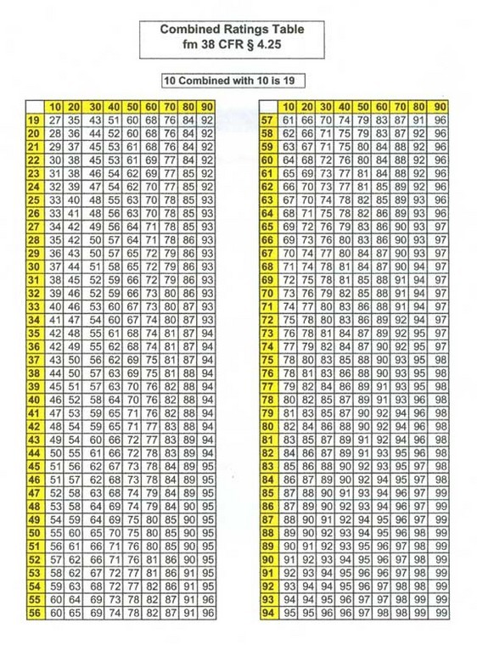
Notes:
We must continue to serve the men and women who know DAV, our members and the veterans we serve.
And, it’s also our responsibility to reach out and make ourselves known to the disabled American veterans who don’t know the breadth of DAV services so they are in a better position to regain their sense of normalcy and live a life with dignity and respect.
Ensuring the effectiveness of our outreach was a key motivation for recent research.
We all know the importance of remaining relevant and reaching out to the millions of veterans returning from Iraq & Afghanistan and continue to stay “present” for the many thousands already here.
*Note: Dan, we think that using injured instead of disabled at the beginning of the presentation might create some culture shock. We move to that language further into the ppt.

Slide 64

DSO-CSO Level II Training
Standardized Forms, Fully Developed Claims and Appeals Modernization Act
Notes:
We must continue to serve the men and women who know DAV, our members and the veterans we serve.
And, it’s also our responsibility to reach out and make ourselves known to the disabled American veterans who don’t know the breadth of DAV services so they are in a better position to regain their sense of normalcy and live a life with dignity and respect.
Ensuring the effectiveness of our outreach was a key motivation for recent research.
We all know the importance of remaining relevant and reaching out to the millions of veterans returning from Iraq & Afghanistan and continue to stay “present” for the many thousands already here.
*Note: Dan, we think that using injured instead of disabled at the beginning of the presentation might create some culture shock. We move to that language further into the ppt.

Slide 65
Appeals Modernization Act
The new Appeals Modernization Act went into law effective February 19th, 2019.

Slide 66
DSO-CSO Level II Training
Here are the three lanes from which a claimant may choose in seeking review of a decision.
  Supplemental Claim – An opportunity to present a new claim with additional evidence that is new and relevant.
  Higher-Level Review – An entirely new review of the same evidence by a higher-level claim's adjudicator in VBA. You can't submit any additional evidence in this lane.
  BVA Appeal – A Notice of Disagreement will be reviewed by a Veterans Law Judge at the Board of Veterans Appeals (BVA).

Slide 67
DSO-CSO Level II Training
Supplemental Claim cont.
Supplemental claim is a request by an appellant to have their claim/appeal(s) reviewed by VBA based on additional evidence that is new and relevant to the benefit(s) sought.
A supplemental claim must be filed on the appropriate application form with new and relevant evidence, or the Veteran must identify new and relevant evidence that VA can assist in gathering, to be a complete application.
New evidence means evidence not previously submitted to agency adjudicators, and relevant evidence means evidence that tends to prove or disprove a matter in issue in a claim.
Note: An initial election for supplemental claim will be presumed to have new and relevant evidence warranting a decision on the merits.
Note: VA will not decide a claim with incomplete applications.

Slide 68
DSO-CSO Level II Training
Supplemental Claim cont.
The VA can provide the Duty to Assist after a Supplemental Claim has been filed.
What form is a Supplemental?

Slide 69
Supplemental Claim
Use this option when you have additional evidence that is NEW AND RELEVANT to support granting the benefit(s) sought or you can identify existing relevant records that you would like VA to obtain. (NEW evidence means information not previously submitted to VA, and RELEVANT evidence means information that tends to prove or disprove a matter at issue.)

Slide 70
Supplemental Claim
Supplemental claim is a claim where an initial or supplemental claim for the same or similar benefit on the same or similar basis was previously decided.
Must have new and relevant evidence to submit.
Intent to file a claim, now applies to supplemental claims.
As of February 19, 2019, reopened claims or reconsideration claims are no longer available as they fall under the supplemental claim process now.

Slide 71
Important
That’s why it is in Red. DO NOT FILE A SUPPLEMENTAL CLAIM IF YOU ARE NOT SUBMITTING NEW EVIDENCE.
When in doubt what is rule number two.

Slide 72
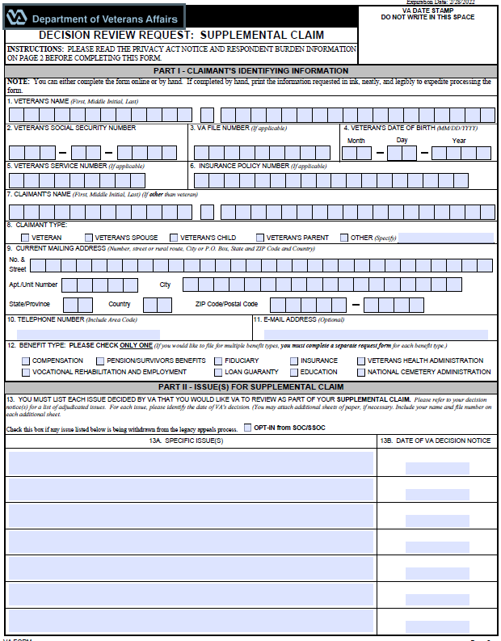
Supplemental Claim (VA Form 20-0995)
Notes:
We must continue to serve the men and women who know DAV, our members and the veterans we serve.
And, it’s also our responsibility to reach out and make ourselves known to the disabled American veterans who don’t know the breadth of DAV services so they are in a better position to regain their sense of normalcy and live a life with dignity and respect.
Ensuring the effectiveness of our outreach was a key motivation for recent research.
We all know the importance of remaining relevant and reaching out to the millions of veterans returning from Iraq & Afghanistan and continue to stay “present” for the many thousands already here.
*Note: Dan, we think that using injured instead of disabled at the beginning of the presentation might create some culture shock. We move to that language further into the ppt.

Slide 73
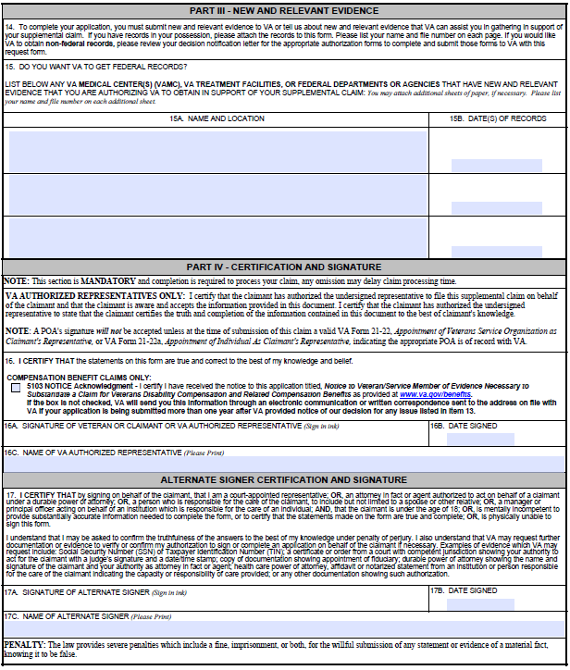
Supplemental Claim

Slide 74
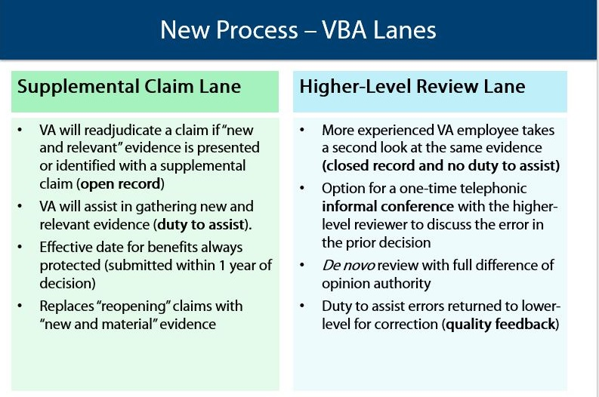
DSO-CSO Level II Training
Supplemental Claim Vs. Higher-Level Review

Slide 75
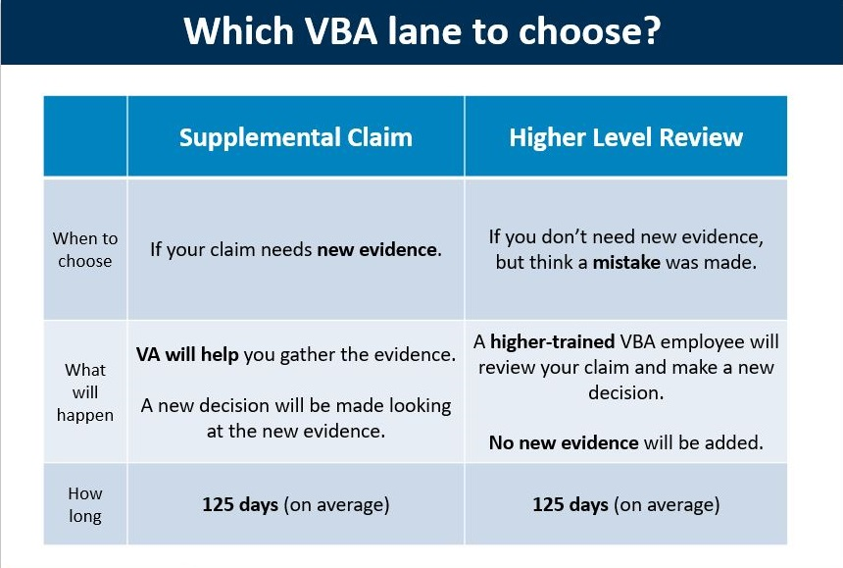
DSO-CSO Level II Training
Supplemental Claim Vs. Higher-Level Review

Slide 76
Higher-Level Review
Use this option when you have NO additional evidence to submit, or that you would like VA to obtain, in support of a previously decided issue.
You may not request a Higher-Level Review of a Higher-Level Review decision or a Board decision.
The designated reviewer will conduct a brand-new review of the issue(s) based on the evidence that was before VA at the time of the prior decision(s).

Slide 77
Higher Level Review
A HLR consists of:
More experienced VA employee takes a second look at the same evidence (closed record and no duty to assist)
De novo review with full difference of opinion authority
Duty to assist errors returned to lower-level for correction (quality feedback)

Slide 78
Higher level Review
Do not file a Higher-level review without speaking to an NSO first.
When In doubt what is the second rule.

Slide 79
DSO-CSO Level II Training
Higher-Level Review
A claimant is required to file a Higher-Level Review on a form prescribed by the Secretary
Claimants must complete a VA Form 20-0996, Decision Review Request: Higher-Level Review.
The intent to file would not apply to a Higher-Level Review.
Claimants don't have the option of presenting new and relevant evidence outside of a supplemental claim, and the two instances in the BVA lanes. Thus, if any evidence is received outside of those instances, it will not be considered or acted upon in any way.

Slide 80
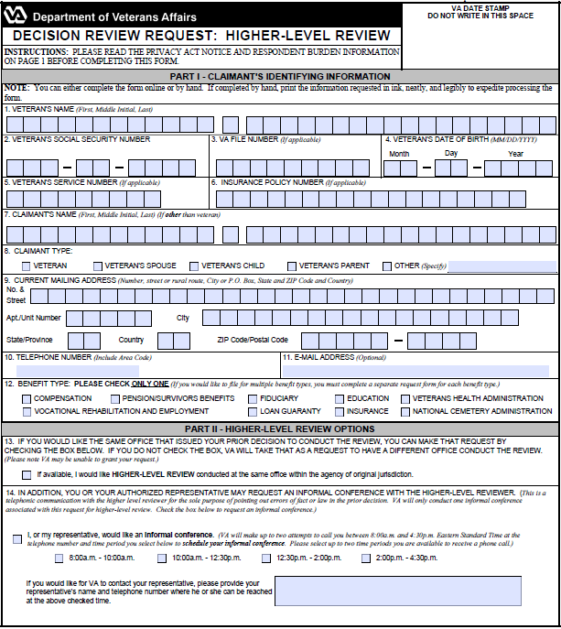
Higher Level review (VA form 20-0996)

Slide 81
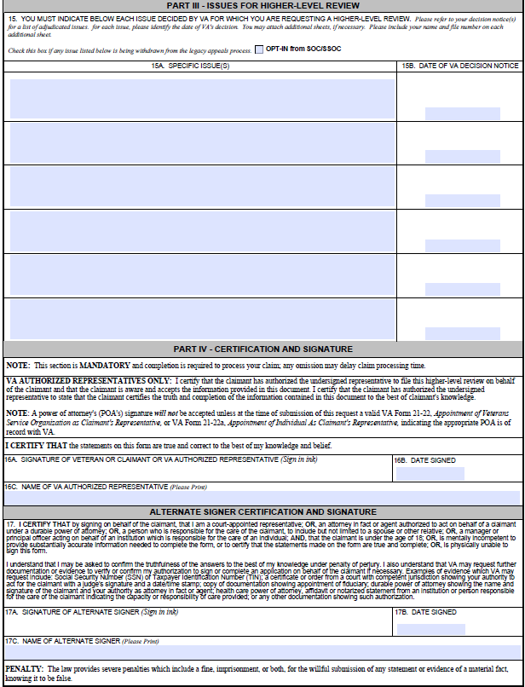

Slide 82
Notice of Disagreement (NOD) 10182
Use this option to appeal to the Board for consideration by a Veterans Law Judge. The claimant may appeal to the Board from a Supplemental Claim decision or a Higher-Level Review decision. A decision must have been made within the past year to be able to file a 10182
When appealing to the Board, the claimant may request a hearing with a Veterans Law Judge and/or the opportunity to submit additional evidence. They may also choose for the Board to review their claim without any additional evidence or a hearing, which may result in a faster decision. By selecting one of these options, the Board will place the appeal onto a list for consideration in the order it was received.

Slide 83
Legacy appeals System
Claimants in the legacy system who received decisions and filed a NOD prior to February 14th, 2019, will remain in the legacy system. Those claimants who wish to opt into the modernized system must wait until a Statement of the Case (SOC) or a Supplemental Statement of the Case (SSOC) is issued and should utilize either the Supplemental claim form 20-0995, the Higher-Level Review Form 20-0996, or the NOD Form 10182 and check the appropriate block in each form to opt into the new system.

Slide 84
DSO-CSO Level II Training
Below are the Board dockets which will allow three separate dockets for handling the following categories of appeals:
  Appeals where the claimant requests Board review on the same evidence that was before the VA Regional Office (VARO).
  Appeals with no request for a hearing but where the claimant elects to submit other forms of evidence.
  Appeals where the claimant has requested a hearing.
It's important to note, two lanes are local VA Regional Office options commonly referred to as local lanes or VBA lanes. Work in either of the local lanes will be assigned through the National Work Queue. The third lane, the BVA lane is worked directly by the BVA in Washington DC.

Slide 85
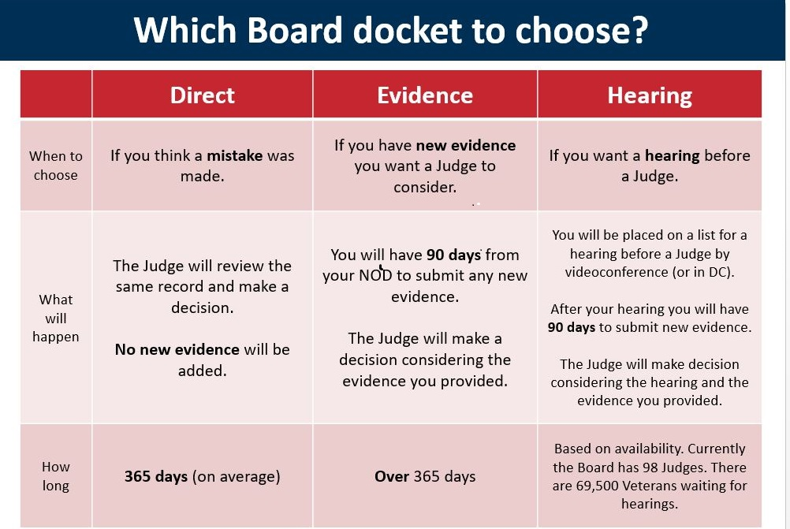
DSO-CSO Level II Training
Which Board Docket to choose?

Slide 86
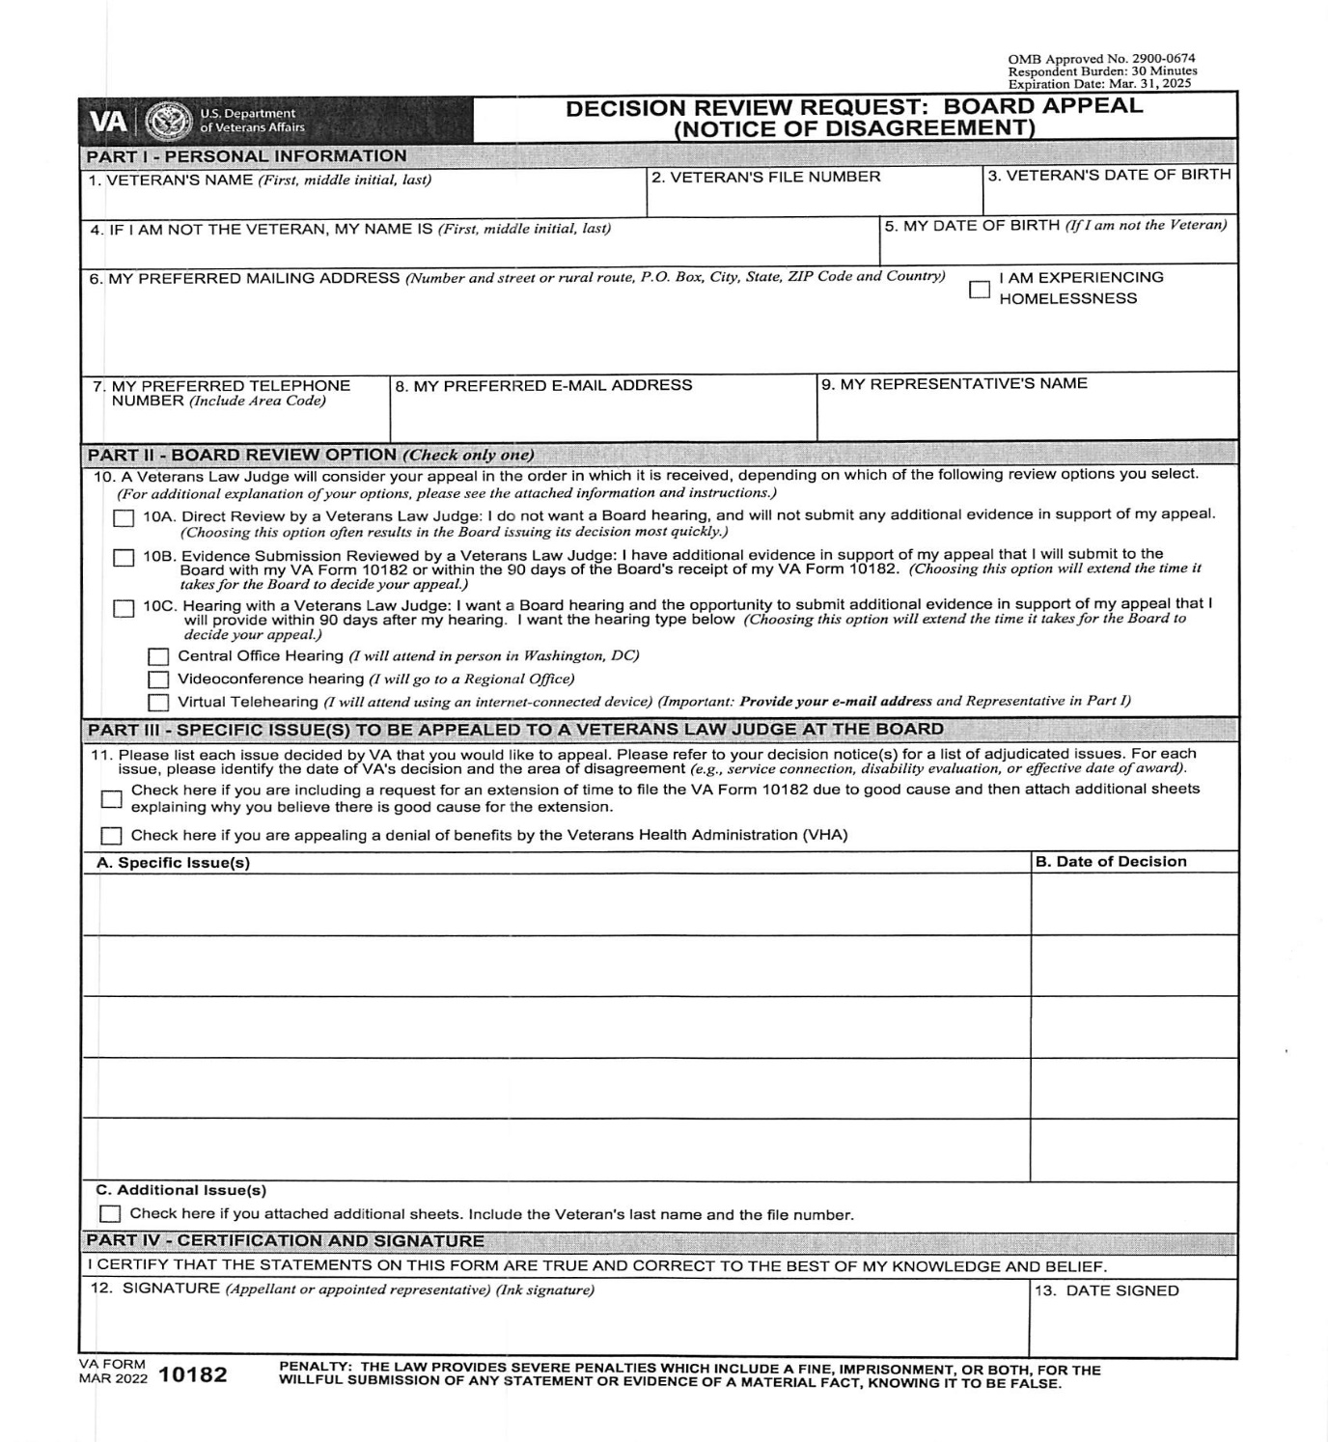
Notice of Disagreement (VA form 10182)

Slide 87
Notice of Disagreement form 10182
A CSO must have the claimant call or email the NSO office if the claimant wants to file an appeal.
The CSO is not allowed to submit a NOD 10182.
The NSO’s need to look at the claimant’s case and see if filing an appeal is the best option or not.

Slide 88
NSO Nashville email address
Please email all claims, evidence, etc. to the email below!!!!!!
DAV.VBANAS@VA.GOV

Slide 89

DSO-CSO Level II Training
Service Connection
for PTSD
Notes:
We must continue to serve the men and women who know DAV, our members and the veterans we serve.
And, it’s also our responsibility to reach out and make ourselves known to the disabled American veterans who don’t know the breadth of DAV services so they are in a better position to regain their sense of normalcy and live a life with dignity and respect.
Ensuring the effectiveness of our outreach was a key motivation for recent research.
We all know the importance of remaining relevant and reaching out to the millions of veterans returning from Iraq & Afghanistan and continue to stay “present” for the many thousands already here.
*Note: Dan, we think that using injured instead of disabled at the beginning of the presentation might create some culture shock. We move to that language further into the ppt.

Slide 90
DSO-CSO Level II Training
Post Traumatic Stress Disorder (PTSD)
PTSD is defined in the Diagnostic and Statistical Manual of Mental Disorders (DSM-5) as a trauma and stress related disorder caused by exposure to a traumatic or stressful event (stressor).
It is not uncommon to include symptoms of anxiety, depression, fearfulness, externalizing angry or aggressive features, isolation, memory impairment, sleep impairment, and lack of interest in once enjoyed activities.
Notes:
We must continue to serve the men and women who know DAV, our members and the veterans we serve.
And, it’s also our responsibility to reach out and make ourselves known to the disabled American veterans who don’t know the breadth of DAV services so they are in a better position to regain their sense of normalcy and live a life with dignity and respect.
Ensuring the effectiveness of our outreach was a key motivation for recent research.
We all know the importance of remaining relevant and reaching out to the millions of veterans returning from Iraq & Afghanistan and continue to stay “present” for the many thousands already here.
*Note: Dan, we think that using injured instead of disabled at the beginning of the presentation might create some culture shock. We move to that language further into the ppt.

Slide 91
DSO-CSO Level II Training
Post Traumatic Stress Disorder (PTSD)
PTSD can be service-connected as related to military service. There are currently 5 ways to establish service-connection for PTSD. 38 CFR 3.304(f)(1-5)
If the veteran was diagnosed while on active duty, the stressor is related to that service and has a current diagnosis of PTSD.
If the veteran was engaged in combat with the enemy, the stressor is related to said combat, and has a current diagnosis of PTSD.
Notes:
We must continue to serve the men and women who know DAV, our members and the veterans we serve.
And, it’s also our responsibility to reach out and make ourselves known to the disabled American veterans who don’t know the breadth of DAV services so they are in a better position to regain their sense of normalcy and live a life with dignity and respect.
Ensuring the effectiveness of our outreach was a key motivation for recent research.
We all know the importance of remaining relevant and reaching out to the millions of veterans returning from Iraq & Afghanistan and continue to stay “present” for the many thousands already here.
*Note: Dan, we think that using injured instead of disabled at the beginning of the presentation might create some culture shock. We move to that language further into the ppt.

Slide 92
DSO-CSO Level II Training
Post Traumatic Stress Disorder (PTSD)
  Combat with the enemy can be proven with combat awards, Personnel records, and the DD 214.
  If the veteran does not have a combat award, it can still be established if it is proven the veteran was at the location of a combat event.
  If the combat cannot be verified consider establishing it based on a statement of fear as discussed next.
Notes:
We must continue to serve the men and women who know DAV, our members and the veterans we serve.
And, it’s also our responsibility to reach out and make ourselves known to the disabled American veterans who don’t know the breadth of DAV services so they are in a better position to regain their sense of normalcy and live a life with dignity and respect.
Ensuring the effectiveness of our outreach was a key motivation for recent research.
We all know the importance of remaining relevant and reaching out to the millions of veterans returning from Iraq & Afghanistan and continue to stay “present” for the many thousands already here.
*Note: Dan, we think that using injured instead of disabled at the beginning of the presentation might create some culture shock. We move to that language further into the ppt.

Slide 93
DSO-CSO Level II Training
Post Traumatic Stress Disorder (PTSD)
If the veteran has a current diagnosis of PTSD, a statement of fear of hostile military or terrorist activity, and a VA or VA contracted psychiatrist or psychologist confirms the statement of fear is adequate to support a diagnosis of PTSD, to include its relationship to the statement of fear.
  This is often referred to as the “relaxed stressor” requirement
Notes:
We must continue to serve the men and women who know DAV, our members and the veterans we serve.
And, it’s also our responsibility to reach out and make ourselves known to the disabled American veterans who don’t know the breadth of DAV services so they are in a better position to regain their sense of normalcy and live a life with dignity and respect.
Ensuring the effectiveness of our outreach was a key motivation for recent research.
We all know the importance of remaining relevant and reaching out to the millions of veterans returning from Iraq & Afghanistan and continue to stay “present” for the many thousands already here.
*Note: Dan, we think that using injured instead of disabled at the beginning of the presentation might create some culture shock. We move to that language further into the ppt.

Slide 94
DSO-CSO Level II Training
Post Traumatic Stress Disorder (PTSD)
  Fear of hostile military or terrorist activity includes being located within area endemic to those circumstances and was confronted with an event or circumstance that involved actual or threatened death or serious injury, or a threat to the physical integrity of the veteran or others
  Examples
Notes:
We must continue to serve the men and women who know DAV, our members and the veterans we serve.
And, it’s also our responsibility to reach out and make ourselves known to the disabled American veterans who don’t know the breadth of DAV services so they are in a better position to regain their sense of normalcy and live a life with dignity and respect.
Ensuring the effectiveness of our outreach was a key motivation for recent research.
We all know the importance of remaining relevant and reaching out to the millions of veterans returning from Iraq & Afghanistan and continue to stay “present” for the many thousands already here.
*Note: Dan, we think that using injured instead of disabled at the beginning of the presentation might create some culture shock. We move to that language further into the ppt.

Slide 95
DSO-CSO Level II Training
Post Traumatic Stress Disorder (PTSD)
If the veteran is a confirmed former Prisoner of War, the stressor is related that experience, and has a current diagnosis of PTSD.
If the veteran is claiming PTSD based on an in-service personal assault and the assault can be corroborated, has a diagnosis of PTSD and is related to the personal assault.
Notes:
We must continue to serve the men and women who know DAV, our members and the veterans we serve.
And, it’s also our responsibility to reach out and make ourselves known to the disabled American veterans who don’t know the breadth of DAV services so they are in a better position to regain their sense of normalcy and live a life with dignity and respect.
Ensuring the effectiveness of our outreach was a key motivation for recent research.
We all know the importance of remaining relevant and reaching out to the millions of veterans returning from Iraq & Afghanistan and continue to stay “present” for the many thousands already here.
*Note: Dan, we think that using injured instead of disabled at the beginning of the presentation might create some culture shock. We move to that language further into the ppt.

Slide 96
DSO-CSO Level II Training
Post Traumatic Stress Disorder (PTSD)
  This does not require verification of the assault, only corroboration.
  This includes any type of personal assault such as rape, sexual harassment, muggings, personal attacks.
  Corroboration can be obtained through lay statements, personnel records, treatment records, hospital records, police records, etc.
Notes:
We must continue to serve the men and women who know DAV, our members and the veterans we serve.
And, it’s also our responsibility to reach out and make ourselves known to the disabled American veterans who don’t know the breadth of DAV services so they are in a better position to regain their sense of normalcy and live a life with dignity and respect.
Ensuring the effectiveness of our outreach was a key motivation for recent research.
We all know the importance of remaining relevant and reaching out to the millions of veterans returning from Iraq & Afghanistan and continue to stay “present” for the many thousands already here.
*Note: Dan, we think that using injured instead of disabled at the beginning of the presentation might create some culture shock. We move to that language further into the ppt.

Slide 97
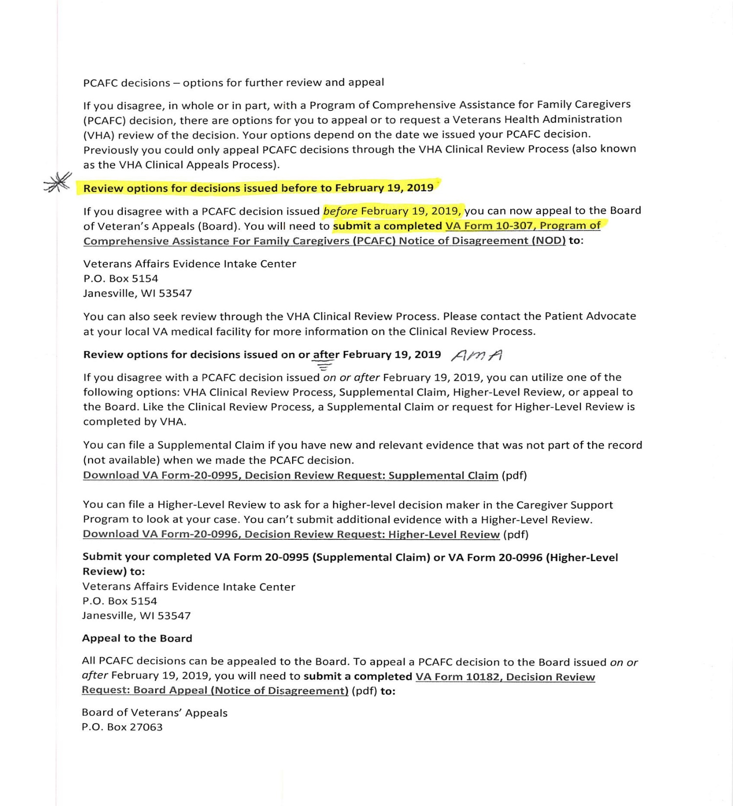

Slide 98
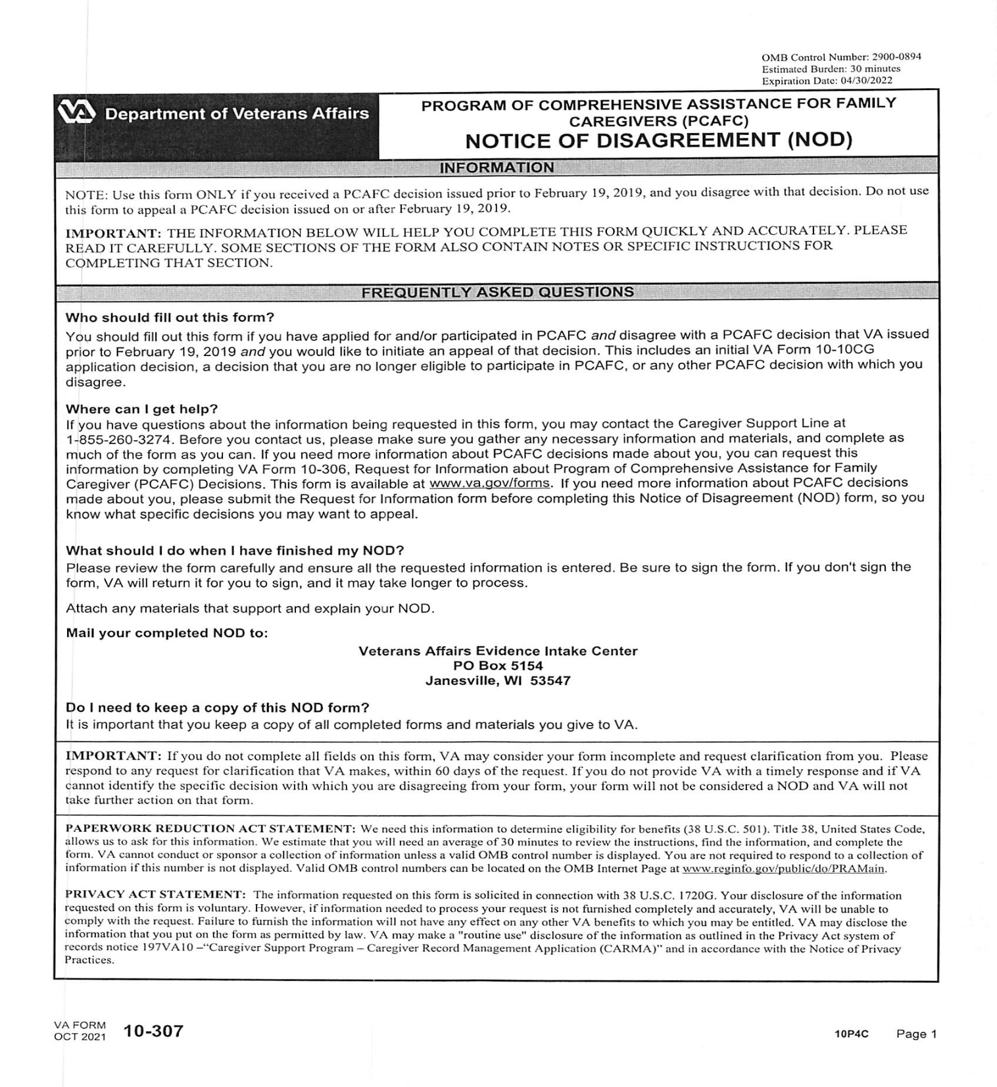

Slide 99
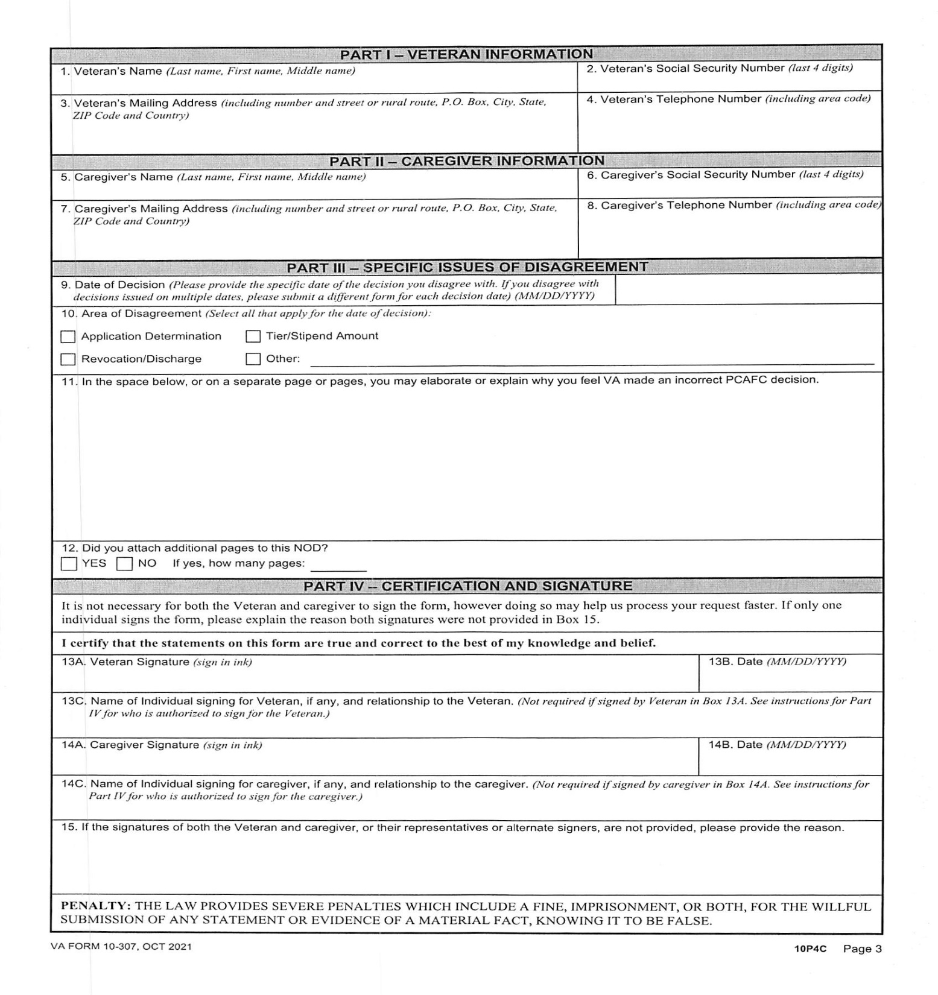

Slide 100

DSO-CSO Level II Training
Military Sexual
Trauma Claims
Notes:
We must continue to serve the men and women who know DAV, our members and the veterans we serve.
And, it’s also our responsibility to reach out and make ourselves known to the disabled American veterans who don’t know the breadth of DAV services so they are in a better position to regain their sense of normalcy and live a life with dignity and respect.
Ensuring the effectiveness of our outreach was a key motivation for recent research.
We all know the importance of remaining relevant and reaching out to the millions of veterans returning from Iraq & Afghanistan and continue to stay “present” for the many thousands already here.
*Note: Dan, we think that using injured instead of disabled at the beginning of the presentation might create some culture shock. We move to that language further into the ppt.

Slide 101
DSO-CSO Level II Training
Military Sexual Trauma
MST is a term used by VA to refer to a sexual assault or sexual harassment that occurred during military service. This includes women and men.
More than 20% of females are sexually assaulted while serving their country
A female service member is more likely to be raped than killed in combat
The military prosecutes less than 5% of the reported sexual assault cases
Notes:
We must continue to serve the men and women who know DAV, our members and the veterans we serve.
And, it’s also our responsibility to reach out and make ourselves known to the disabled American veterans who don’t know the breadth of DAV services so they are in a better position to regain their sense of normalcy and live a life with dignity and respect.
Ensuring the effectiveness of our outreach was a key motivation for recent research.
We all know the importance of remaining relevant and reaching out to the millions of veterans returning from Iraq & Afghanistan and continue to stay “present” for the many thousands already here.
*Note: Dan, we think that using injured instead of disabled at the beginning of the presentation might create some culture shock. We move to that language further into the ppt.

Slide 102
DSO-CSO Level II Training
Military Sexual Trauma
According to DoD, 86.5% of sexual assaults are not reported, meaning that official documentation of many assaults may not exist.
PTSD and other mental health conditions such as depression, anxiety, adjustment disorder, dissociative disorders, borderline personality disorder and substance abuse are linked to MST.
Notes:
We must continue to serve the men and women who know DAV, our members and the veterans we serve.
And, it’s also our responsibility to reach out and make ourselves known to the disabled American veterans who don’t know the breadth of DAV services so they are in a better position to regain their sense of normalcy and live a life with dignity and respect.
Ensuring the effectiveness of our outreach was a key motivation for recent research.
We all know the importance of remaining relevant and reaching out to the millions of veterans returning from Iraq & Afghanistan and continue to stay “present” for the many thousands already here.
*Note: Dan, we think that using injured instead of disabled at the beginning of the presentation might create some culture shock. We move to that language further into the ppt.

Slide 103
DSO-CSO Level II Training
Military Sexual Trauma
Victims of MST may also have physical health problems like gastrointestinal symptoms, back pain, headaches, sexual dysfunction or chronic fatigue.
The VA provides free treatment for all conditions (physical and mental) related to MST.
Even if a veteran is not eligible for VA Healthcare, they can still be eligible for free treatment due to MST.
Notes:
We must continue to serve the men and women who know DAV, our members and the veterans we serve.
And, it’s also our responsibility to reach out and make ourselves known to the disabled American veterans who don’t know the breadth of DAV services so they are in a better position to regain their sense of normalcy and live a life with dignity and respect.
Ensuring the effectiveness of our outreach was a key motivation for recent research.
We all know the importance of remaining relevant and reaching out to the millions of veterans returning from Iraq & Afghanistan and continue to stay “present” for the many thousands already here.
*Note: Dan, we think that using injured instead of disabled at the beginning of the presentation might create some culture shock. We move to that language further into the ppt.

Slide 104
DSO-CSO Level II Training
Military Sexual Trauma
Due to the personal and sensitive nature of MST stressors, victims often do not report or document the event when it occurs due to shame, guilt, or fear of reprisal.
VA has specific regulations and procedures for MST claims that assist in developing evidence to support these claims. Regulations with special liberalizing considerations for claims for PTSD based on MST are found in 38 C.F.R. Section 3.304(f)(5).
Notes:
We must continue to serve the men and women who know DAV, our members and the veterans we serve.
And, it’s also our responsibility to reach out and make ourselves known to the disabled American veterans who don’t know the breadth of DAV services so they are in a better position to regain their sense of normalcy and live a life with dignity and respect.
Ensuring the effectiveness of our outreach was a key motivation for recent research.
We all know the importance of remaining relevant and reaching out to the millions of veterans returning from Iraq & Afghanistan and continue to stay “present” for the many thousands already here.
*Note: Dan, we think that using injured instead of disabled at the beginning of the presentation might create some culture shock. We move to that language further into the ppt.

Slide 105
Military Sexual Trauma.
IF a claimant is not comfortable speaking to you about the situation there is a counselor within the VA. A male and a female to assist the veteran in filing a claim.
Refer to rule two and they will assist with the coordination.

Slide 106

DSO-CSO Level II Training
Military Sexual Trauma
DAV has expanded the Service Officer Guide chapter on Compensation to include extensive information about helping veterans file MST claims, including interview techniques for service officers when assisting potential claimants.
Pages 106-109 Training Guide
Notes:
We must continue to serve the men and women who know DAV, our members and the veterans we serve.
And, it’s also our responsibility to reach out and make ourselves known to the disabled American veterans who don’t know the breadth of DAV services so they are in a better position to regain their sense of normalcy and live a life with dignity and respect.
Ensuring the effectiveness of our outreach was a key motivation for recent research.
We all know the importance of remaining relevant and reaching out to the millions of veterans returning from Iraq & Afghanistan and continue to stay “present” for the many thousands already here.
*Note: Dan, we think that using injured instead of disabled at the beginning of the presentation might create some culture shock. We move to that language further into the ppt.

Slide 107
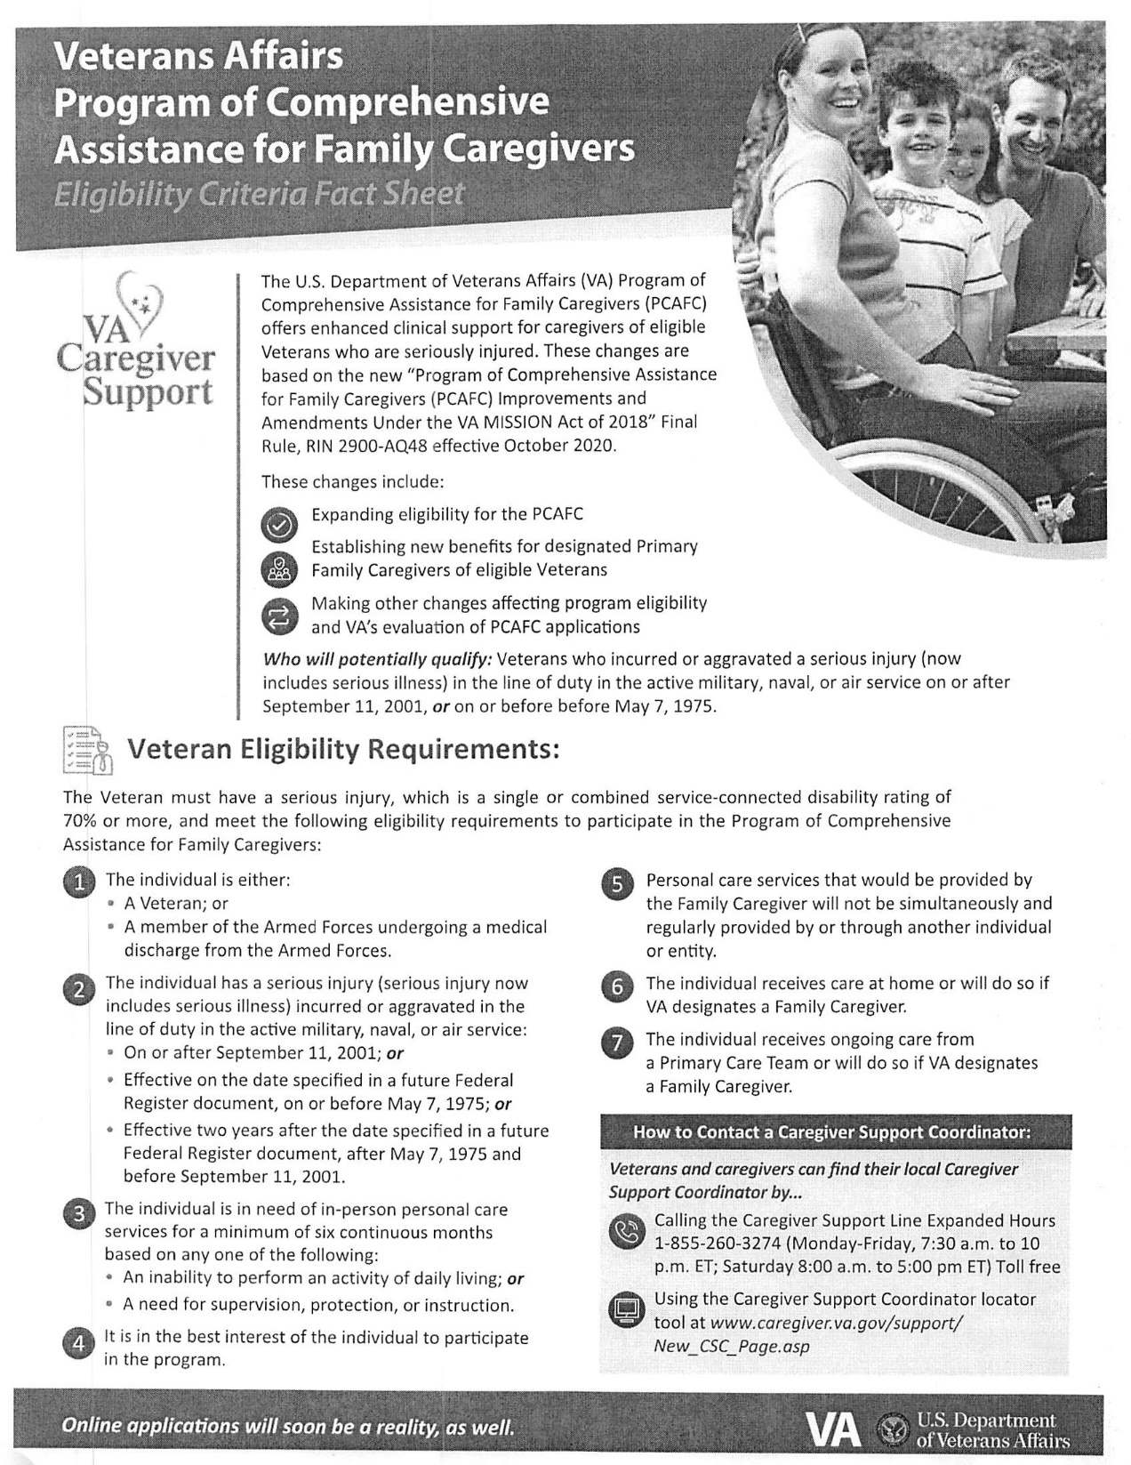

Slide 108
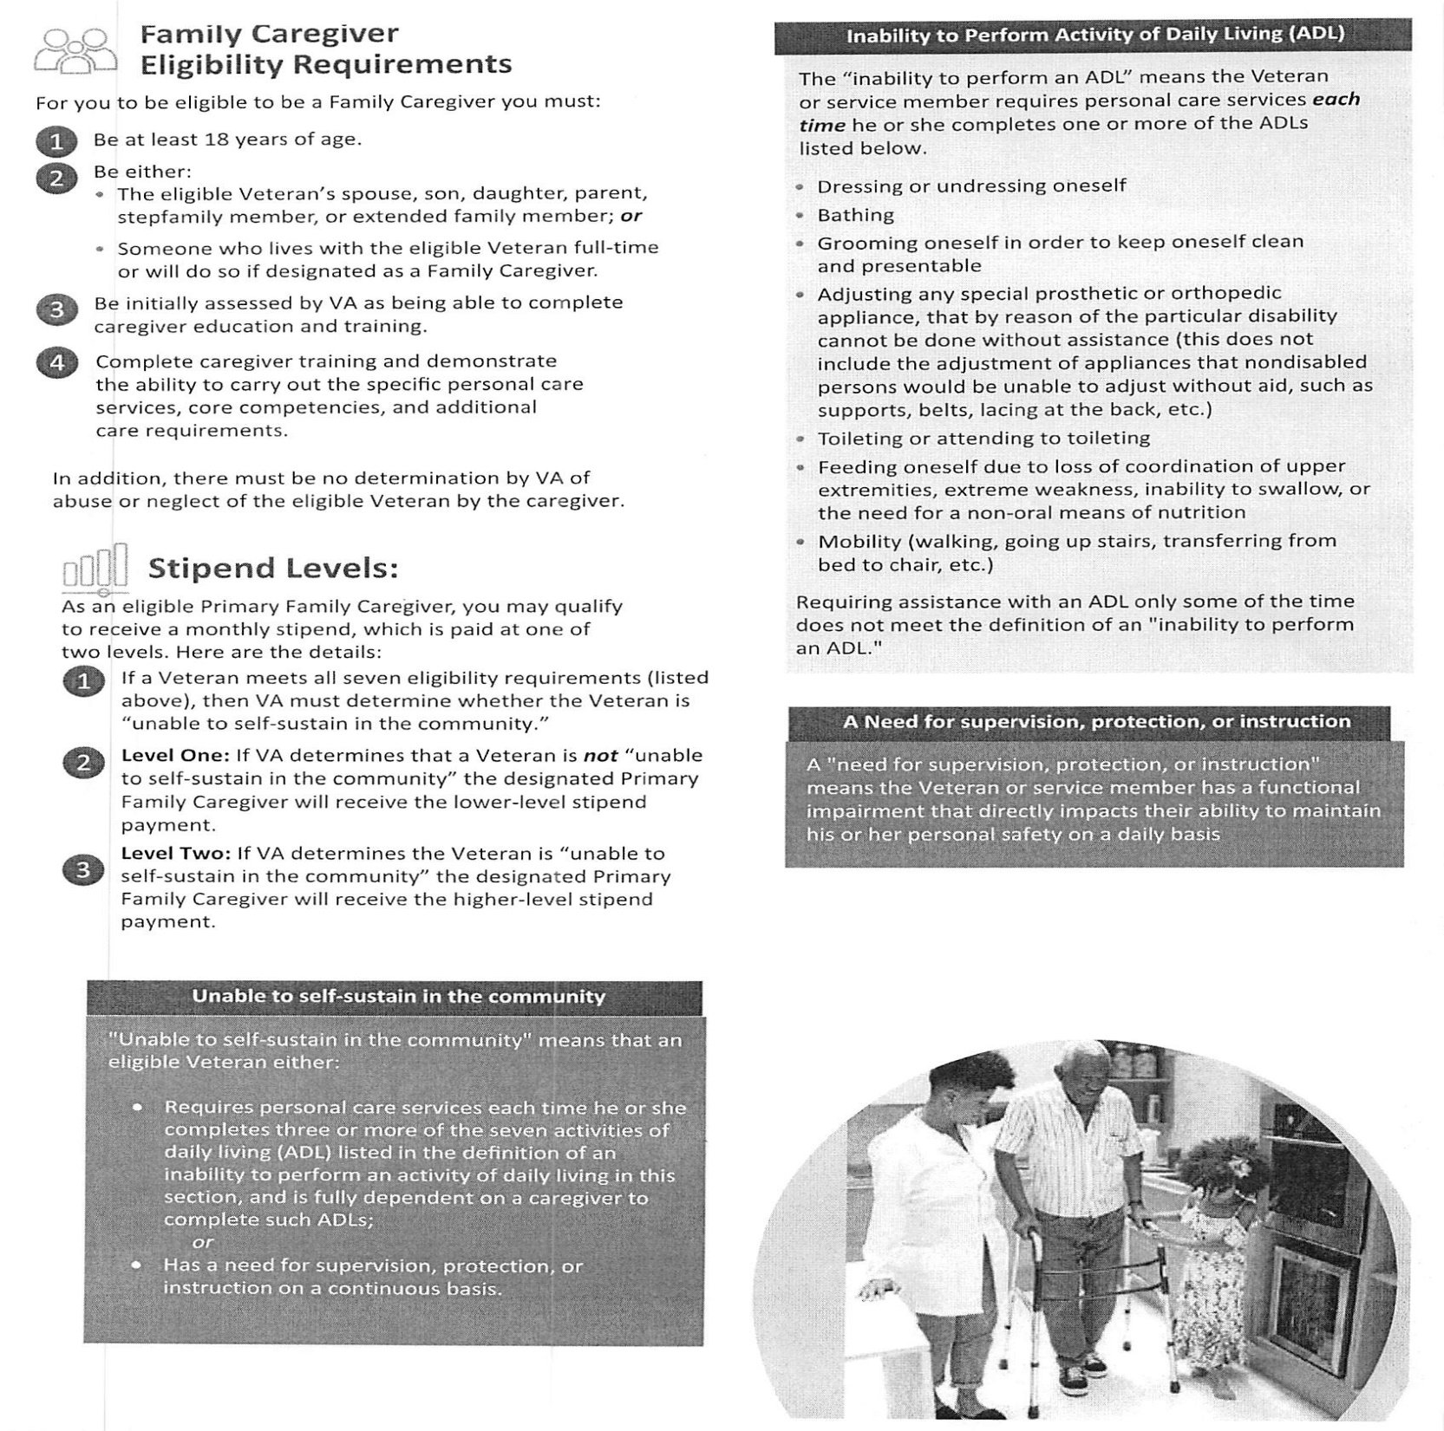

Slide 109

DSO-CSO Level II Training
Mission Act Community Care

Slide 110
What is the VA MISSION of 2018 Act?
DSO-CSO Level II Training
The VA MISSION Act of 2018 is the foundation that will fundamentally transform elements of VA’s health care system.
VA Maintaining Internal Systems and Strengthening Integrated Outside Networks Act of 2018 was signed into law by the President on June 6, 2018. (the MISSION Act). The ACT was implemented June 6, 2019
Notes:
We must continue to serve the men and women who know DAV, our members and the veterans we serve.
And, it’s also our responsibility to reach out and make ourselves known to the disabled American veterans who don’t know the breadth of DAV services so they are in a better position to regain their sense of normalcy and live a life with dignity and respect.
Ensuring the effectiveness of our outreach was a key motivation for recent research.
We all know the importance of remaining relevant and reaching out to the millions of veterans returning from Iraq & Afghanistan and continue to stay “present” for the many thousands already here.
*Note: Dan, we think that using injured instead of disabled at the beginning of the presentation might create some culture shock. We move to that language further into the ppt.

Slide 111
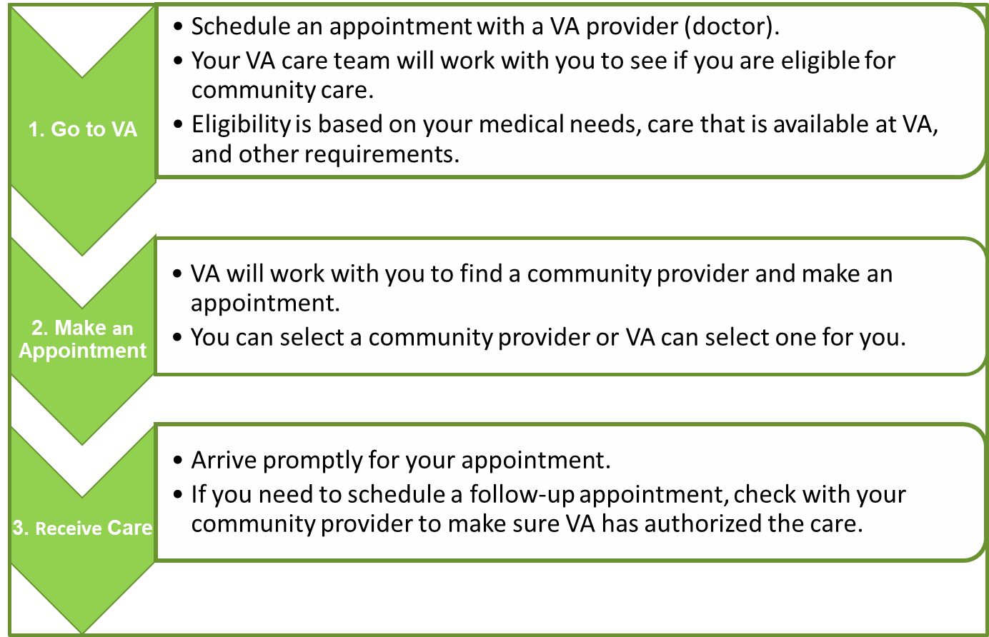
DSO-CSO Level II Training
IMPORTANT:
Make sure VA confirms you are eligible and authorized before proceeding to Step 2.
The community provider selected must be in VA’s network and be willing to accept payment from VA.
If VA has not authorized follow-up care, your community provider should contact VA to arrange the care you need.

Slide 112
DSO-CSO Level II Training
Community Care Eligibility Criteria
Veteran Needs a Service Not Available at a VA Medical Facility
Veteran Lives in a U.S. State or Territory
Without a Full-Service VA Medical Facility
Veteran Qualifies under the “Grandfather” Provision Related to Distance Eligibility for the Veterans Choice Program
VA Cannot Furnish Care within Certain Designated Access Standards
It Is in the Veteran’s Best Medical Interest
A VA Service Line Does Not Meet Certain Quality Standards

Slide 113

DSO-CSO Level II Training
Dos & Don’ts
&
Service Officer Guide
Notes:
We must continue to serve the men and women who know DAV, our members and the veterans we serve.
And, it’s also our responsibility to reach out and make ourselves known to the disabled American veterans who don’t know the breadth of DAV services so they are in a better position to regain their sense of normalcy and live a life with dignity and respect.
Ensuring the effectiveness of our outreach was a key motivation for recent research.
We all know the importance of remaining relevant and reaching out to the millions of veterans returning from Iraq & Afghanistan and continue to stay “present” for the many thousands already here.
*Note: Dan, we think that using injured instead of disabled at the beginning of the presentation might create some culture shock. We move to that language further into the ppt.

Slide 114

DSO-CSO Level II Training
Do!
  Refer all inquiries to the NSO
  Immediately forward all communications to the NSO
  Submit complete and current claimant information
  Maintain contact with the NSO
  Keep it simple
Page 75 Training Guide
Notes:
We must continue to serve the men and women who know DAV, our members and the veterans we serve.
And, it’s also our responsibility to reach out and make ourselves known to the disabled American veterans who don’t know the breadth of DAV services so they are in a better position to regain their sense of normalcy and live a life with dignity and respect.
Ensuring the effectiveness of our outreach was a key motivation for recent research.
We all know the importance of remaining relevant and reaching out to the millions of veterans returning from Iraq & Afghanistan and continue to stay “present” for the many thousands already here.
*Note: Dan, we think that using injured instead of disabled at the beginning of the presentation might create some culture shock. We move to that language further into the ppt.

Slide 115
DSO-CSO Level II Training
Don’t!
  Don’t maintain any claimant files or records
  Don’t complete unfamiliar forms or applications
  Don’t submit any claimant correspondence or evidence directly to VA
  Don’t promise anything
Page 75 Training Guide
Notes:
We must continue to serve the men and women who know DAV, our members and the veterans we serve.
And, it’s also our responsibility to reach out and make ourselves known to the disabled American veterans who don’t know the breadth of DAV services so they are in a better position to regain their sense of normalcy and live a life with dignity and respect.
Ensuring the effectiveness of our outreach was a key motivation for recent research.
We all know the importance of remaining relevant and reaching out to the millions of veterans returning from Iraq & Afghanistan and continue to stay “present” for the many thousands already here.
*Note: Dan, we think that using injured instead of disabled at the beginning of the presentation might create some culture shock. We move to that language further into the ppt.

Slide 116
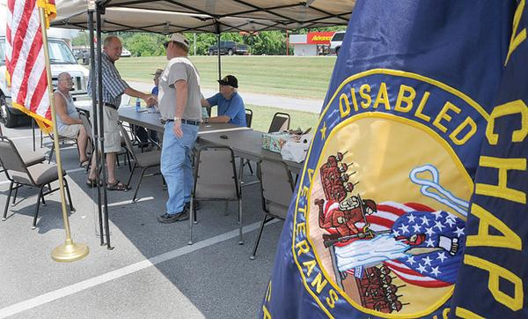
DSO-CSO Level II Training
Department and Chapter Service Officer Information Resource
Available as a digital PDF file on the “Members Only” section of DAV.org.
Notes:
We must continue to serve the men and women who know DAV, our members and the veterans we serve.
And, it’s also our responsibility to reach out and make ourselves known to the disabled American veterans who don’t know the breadth of DAV services so they are in a better position to regain their sense of normalcy and live a life with dignity and respect.
Ensuring the effectiveness of our outreach was a key motivation for recent research.
We all know the importance of remaining relevant and reaching out to the millions of veterans returning from Iraq & Afghanistan and continue to stay “present” for the many thousands already here.
*Note: Dan, we think that using injured instead of disabled at the beginning of the presentation might create some culture shock. We move to that language further into the ppt.

Slide 117
Chapter Service Officers
Chapter Service Officers must be certified annually by successful completion of required training under the supervision of the National Service Program.

Slide 118
Service Officer Guide
The Service Officer Guide is available to service officers for download at:
DAV.org Members Only Section
TYPE in your Membership#
Then Service Officer Guide
Also, www.DAVTN.GOV

Slide 119
Knowledge Assessment
  The Knowledge Assessment consists of:
  30 Questions with Case Study
  Open Book Test
  One hour to Complete
Notes:
We must continue to serve the men and women who know DAV, our members and the veterans we serve.
And, it’s also our responsibility to reach out and make ourselves known to the disabled American veterans who don’t know the breadth of DAV services so they are in a better position to regain their sense of normalcy and live a life with dignity and respect.
Ensuring the effectiveness of our outreach was a key motivation for recent research.
We all know the importance of remaining relevant and reaching out to the millions of veterans returning from Iraq & Afghanistan and continue to stay “present” for the many thousands already here.
*Note: Dan, we think that using injured instead of disabled at the beginning of the presentation might create some culture shock. We move to that language further into the ppt.

Slide 120
Certification
Congratulations!
Thank you for your
attendance and participation!
  Complete the Instructor and Course Critique
  Sign the Training Acknowledgement Form
  Distribution of Certificates
Notes:
We must continue to serve the men and women who know DAV, our members and the veterans we serve.
And, it’s also our responsibility to reach out and make ourselves known to the disabled American veterans who don’t know the breadth of DAV services so they are in a better position to regain their sense of normalcy and live a life with dignity and respect.
Ensuring the effectiveness of our outreach was a key motivation for recent research.
We all know the importance of remaining relevant and reaching out to the millions of veterans returning from Iraq & Afghanistan and continue to stay “present” for the many thousands already here.
*Note: Dan, we think that using injured instead of disabled at the beginning of the presentation might create some culture shock. We move to that language further into the ppt.

Slide 121
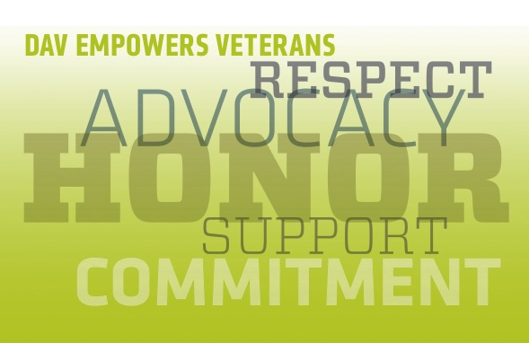

Slide 122
PACT ACT
PROMISE to ADDRESS COMPHREHENSIVE TOXICS ACT

Slide 124
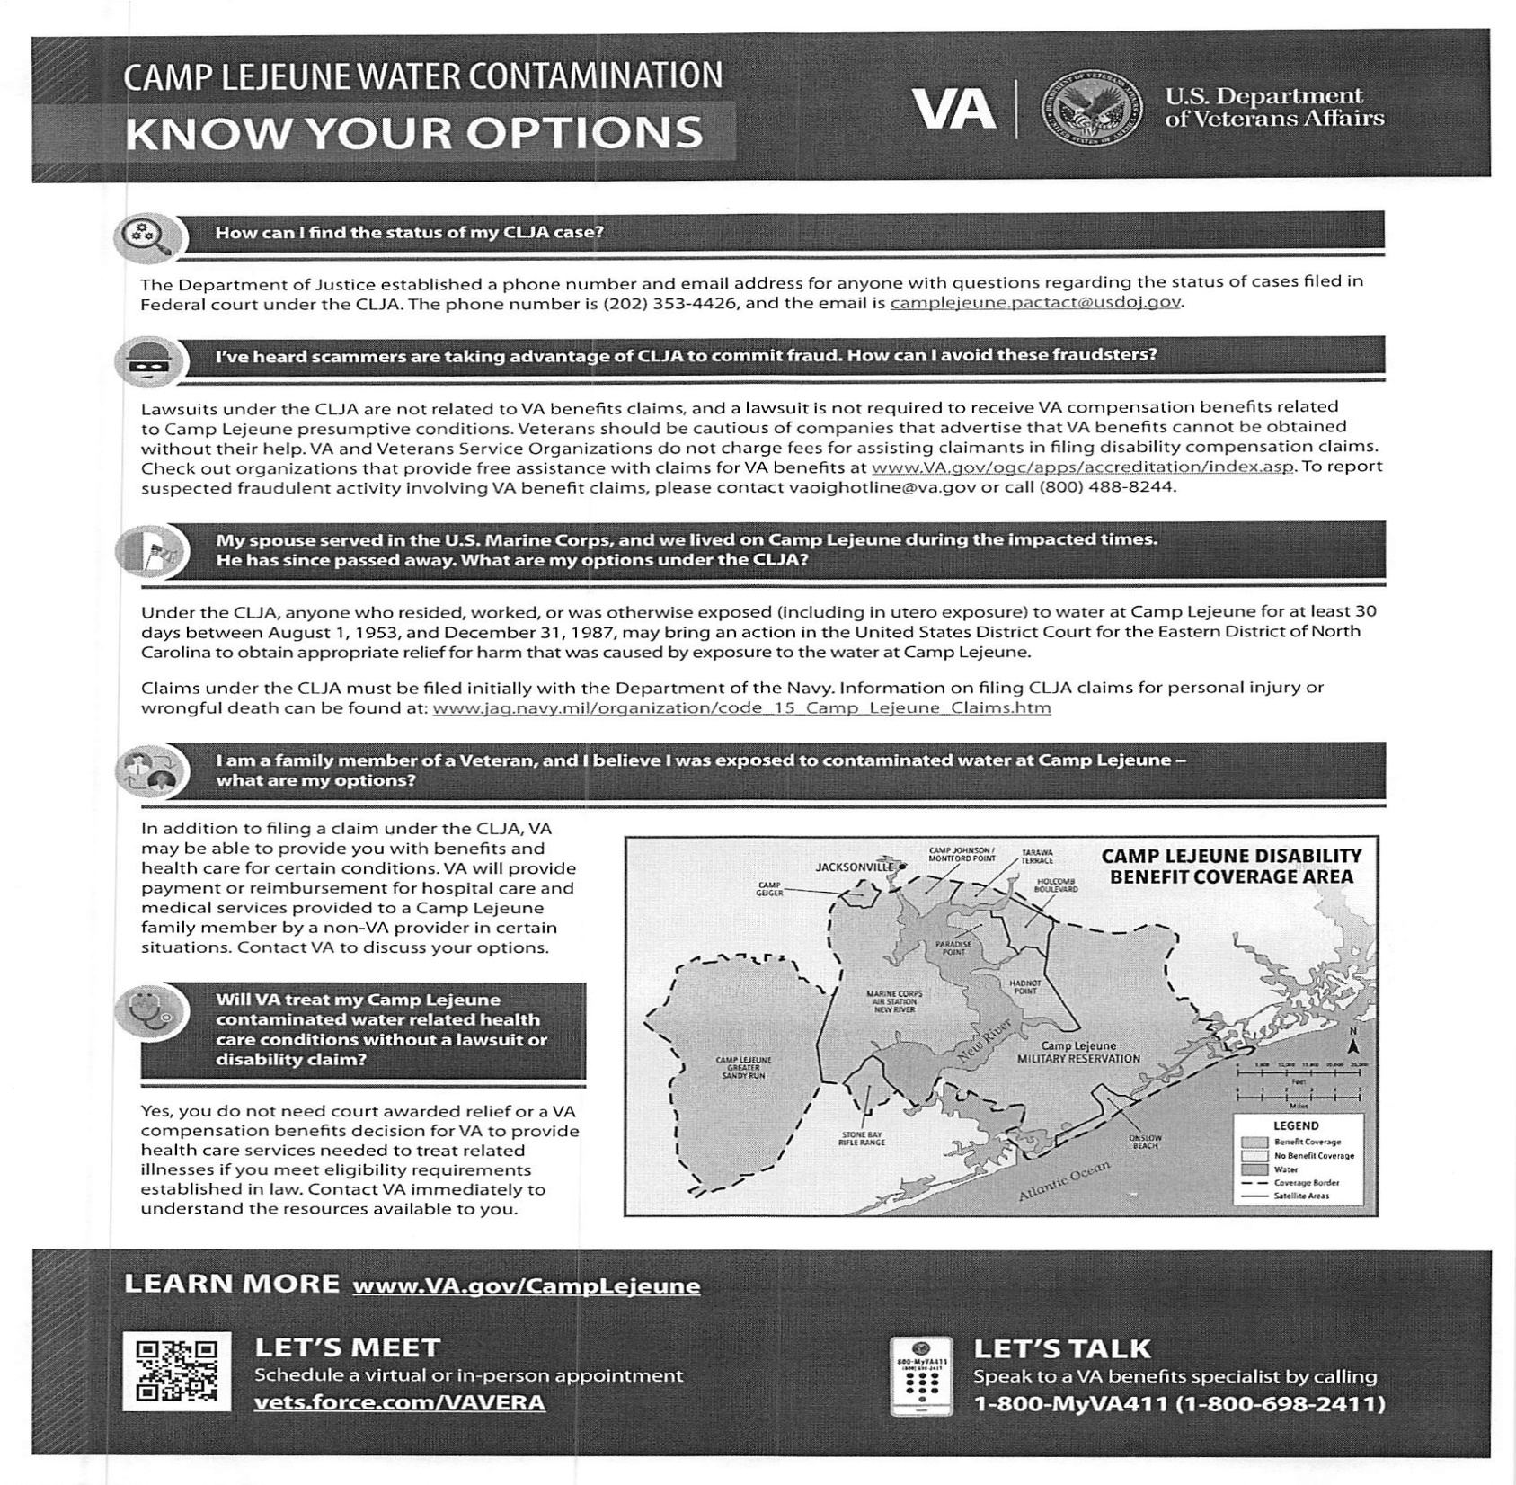

Slide 125
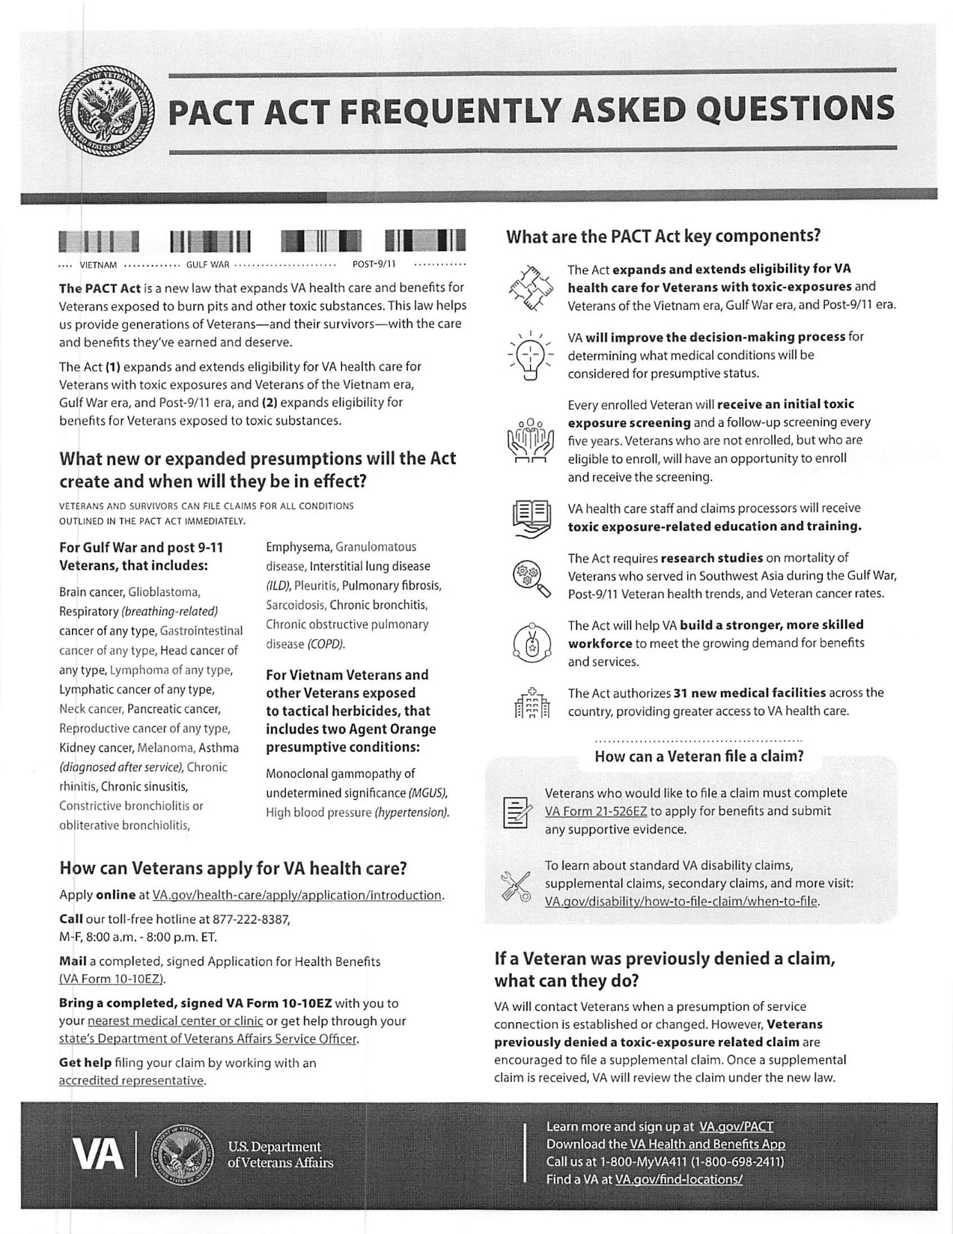

Slide 126
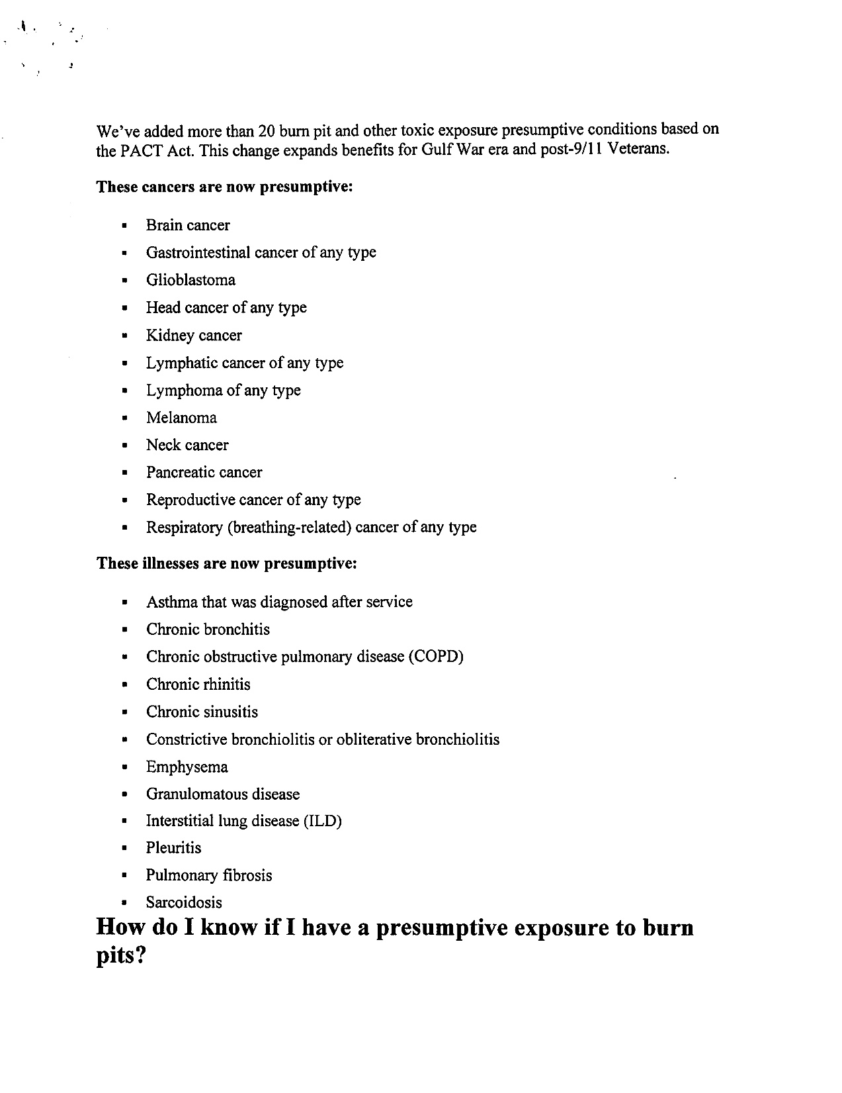

Slide 127
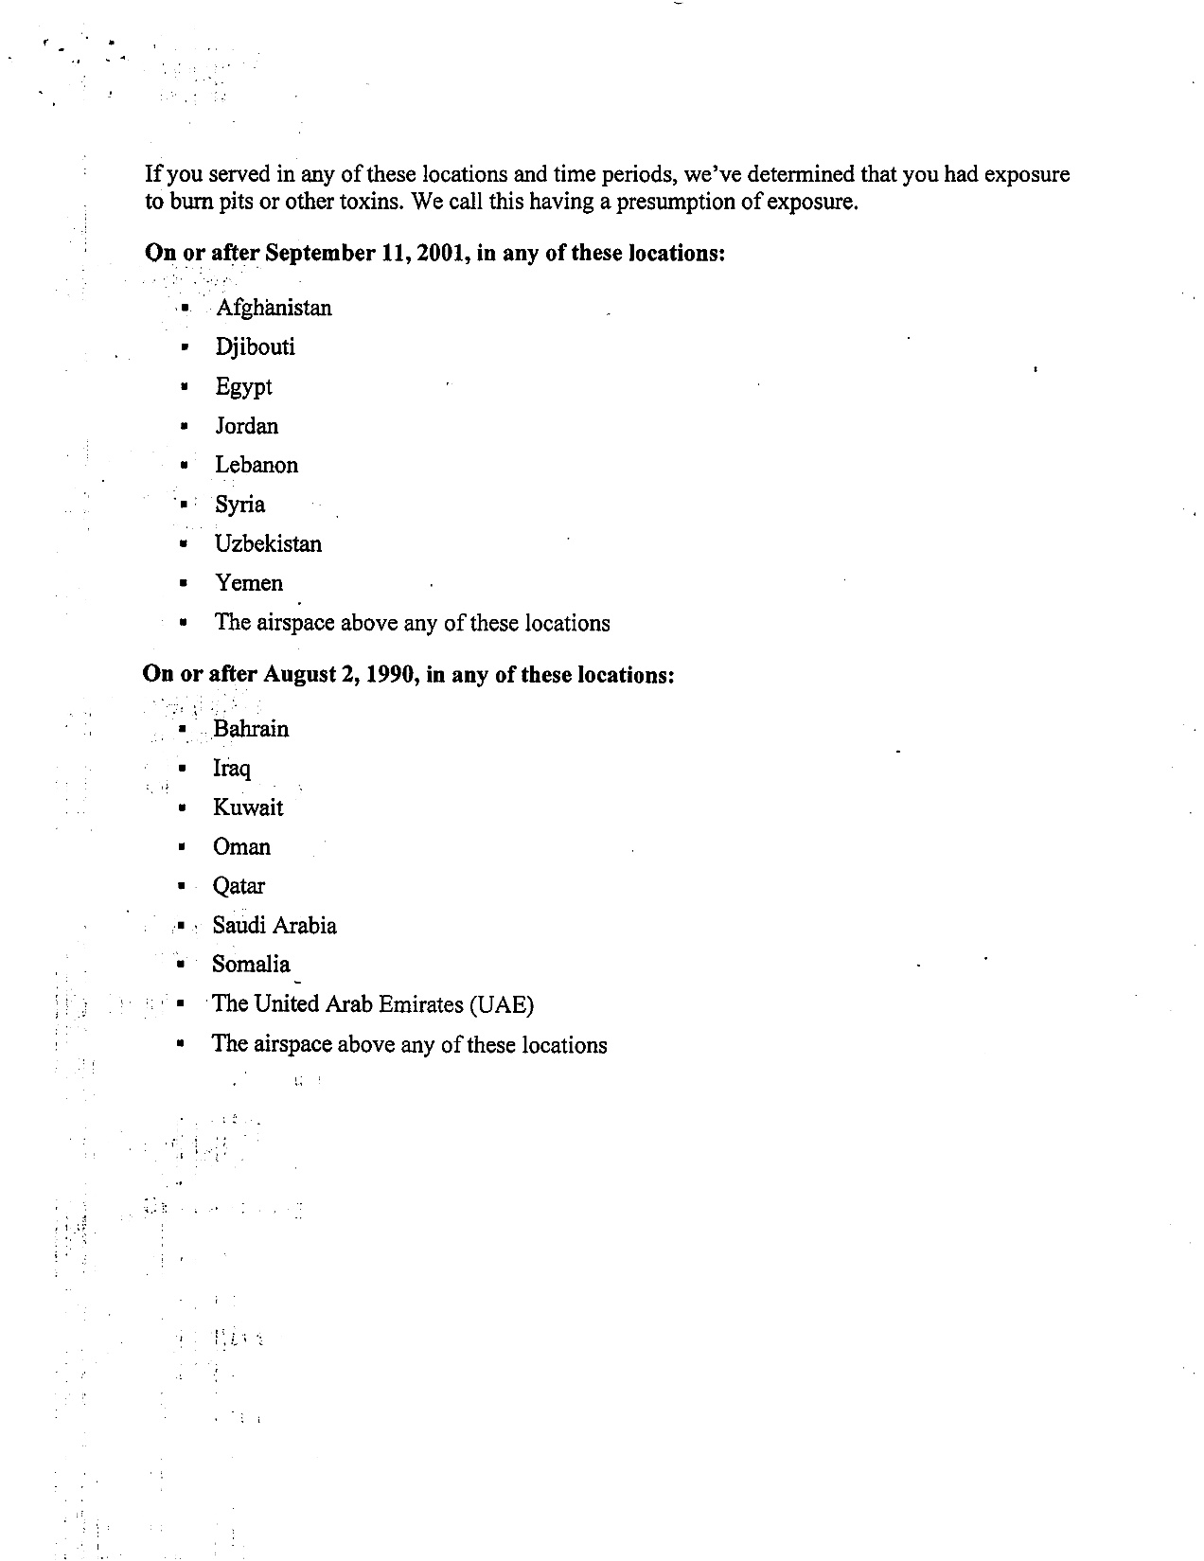

Slide 128
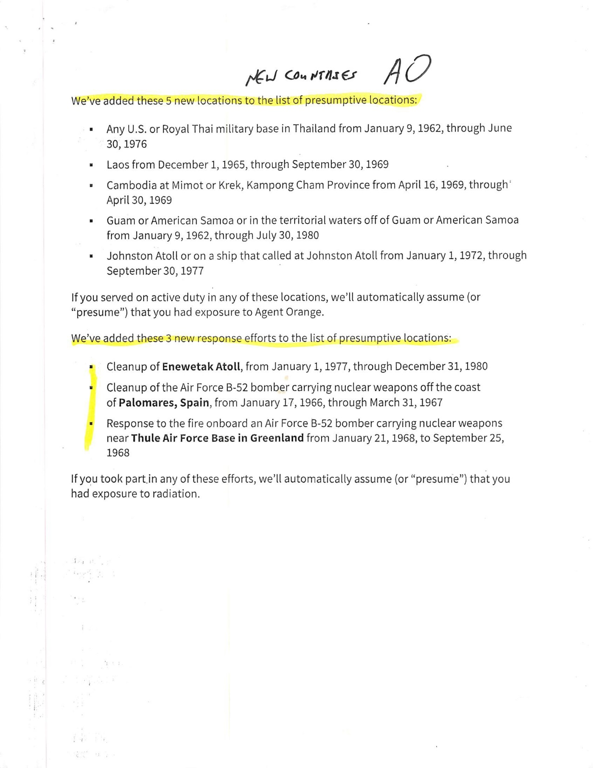

Slide 129
